Slide 1
Technical Advisory Committee
San Benito County Water District
Groundwater Sustainability Agency
January 13, 2020

Slide 2
Overview of Agenda
Update on GSP schedule and progress
Revised Water Budget
Numerical Model
Sustainability Criteria: Water Quality
TAC next steps

Slide 3
Update
Last TAC Meeting
  Water budget
  Sustainability goal statement
Annual Groundwater Report for 2019
  Water quality update
  Transition to fulfill SBCWD and SGMA requirements

Slide 4
Model Improvements
Met with Bolsa growers in November
Implemented new 86-year simulation method for future conditions

Slide 5
Results of Bolsa Grower Meeting
Revised cropping history in Bolsa and nearby areas
Changed irrigation assumptions
  Pasture (irrigated to non-irrigated)
  Shorter growing season in Bolsa
  Shifted vegetable crop season more to summer
  Increased bare-soil evaporation in winter
Recalibrated model
Notes:
Because some of the changes were global (pasture, vegetable crop season, bare-soil ET), results were affected throughout the model, not just in Bolsa.
The new calibration is just as good as the previous one (statistically and in terms of hydrographs).

Slide 6
Simulating Future Conditions
The model and ancillary spreadsheets have been simulating a 43-year period (1975-2017)
SGMA requires exactly 50 years in the future analysis period
A concurrent model application (Pacheco Reservoir) needs simulation of 1922-2003.
Solution: two successive 43-year simulations covering 1922-2007 hydrology
Notes:
Future simulations are now more work than historical ones because all pre- and post-processing has to be done twice, then spliced together.

Slide 7
Simulating Future Conditions—2
Assumptions for future baseline simulation:
  Existing land use (urban footprint, crop types)
  1922-2007vrainfall, ETo and stream flow
  CVP availability from DWR’s CalSim II model
  Current CVP treatment capacity
  Target CVP/GW use for muni supply is 70%/30%
  Initial water levels = September 2012 (typical)

Slide 8
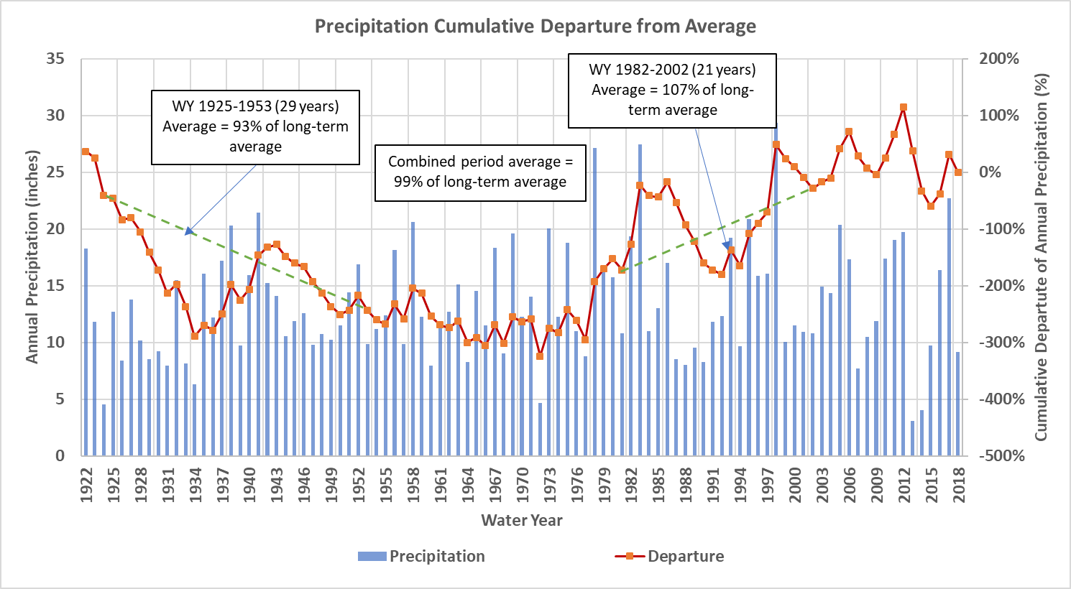
Simulating Future Conditions—3
Notes:
For 50-year water budget averages, select two shorter periods that include major droughts and together = average.

Slide 9
Water Budget Revisions
Tables are slightly different, but relationships among analysis periods and management areas are mostly unchanged.
Irrigation pumping estimates mostly slightly higher because of summer-weighting of vegetable crops.

Slide 10
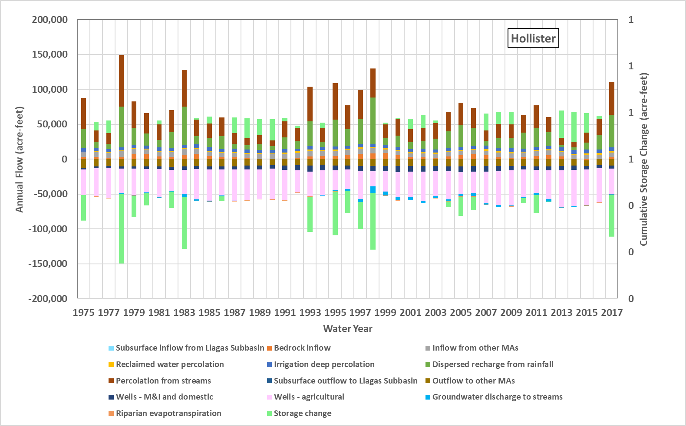
Water Budget Revisions
Notes:
We added storage change to the bar charts so the reader can see that they are balanced.

Slide 11
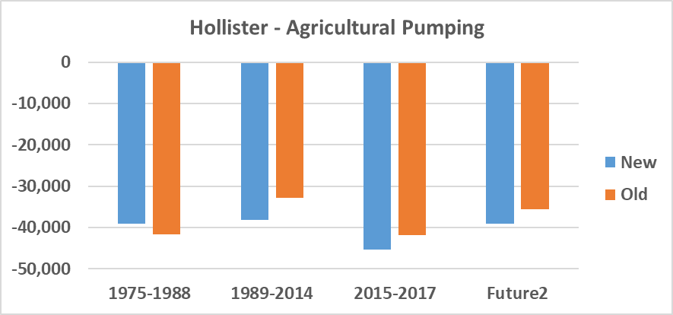
Water Budget Revisions

Slide 12
Water Budget Text Revisions
Response to Comments on water budget section
Storage in Southern MA
Added discussion about future assumptions
Added units and consistent labels to figures

Slide 13
Sustainable Yield Estimate
Same method:
  Based on future baseline simulation
  Yield = simulated pumping + simulated net storage change
  Net storage change ≈ zero, so yield = pumping
Caveat: sustainable yield can be constrained by the occurrence of undesirable results, separate from this water balance approach.
Notes:
No change in method.
New future water balances led to slight increase in estimated sustainable yield in all MAs.

Slide 14
Sustainable Yield Estimate
Revised estimates about 10% larger than previous estimates

Slide 15
Numerical Model
Model will be documented in a GSP appendix
  Grid
  Recharge pre-processing
  Recharge/Runoff equations
  Irrigation and consumptive use details
  Boundary conditions
  Hydraulic parameters
  Calibration

Slide 16
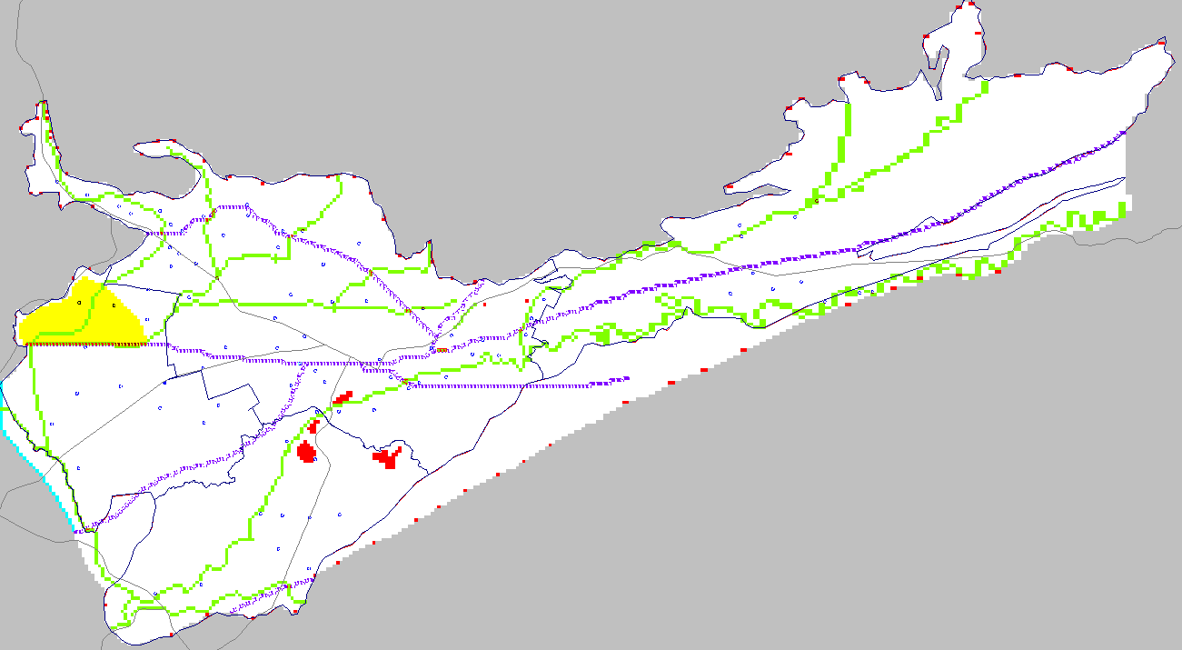
Numerical Model
N
Model Layer 1
Faults
Streams
WWTP percolation and bedrock inflow
Drains
Inactive
200 rows
271 columns

Slide 17
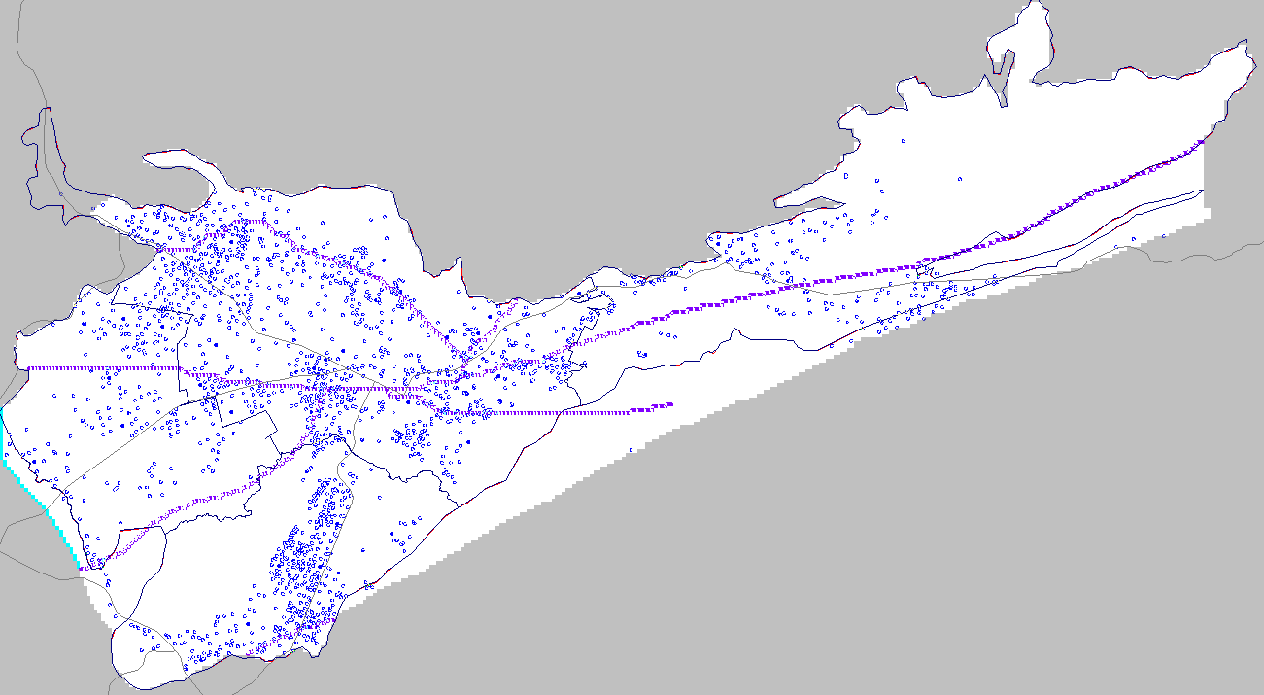
N
Model Layer 3
Faults
Wells
General-head boundary
Notes:
Note that deeper layers (3 through 5) become inactive in shallow parts of the Basin (e.g. Pacheco Creek Valley)
The GHB boundary represents connection with the Llagas Subbasin.
Faults penetrate all layers.
All water supply pumping is in layers 3-4 (except Pacheco Creek Valley)

Slide 18
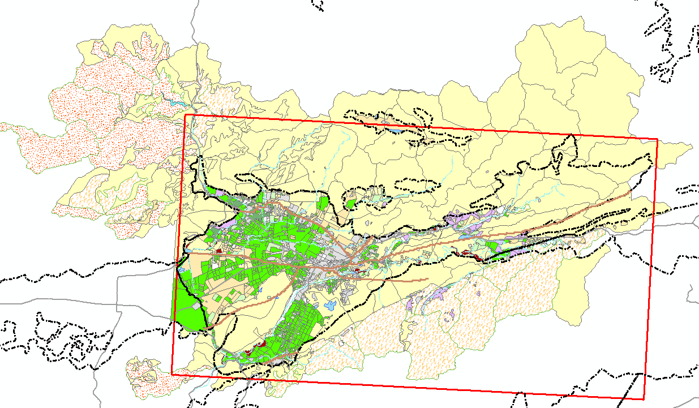
Numerical Model
Rainfall-Runoff-Recharge Polygons
N
Notes:
2,768 polygons
Note that map is rotated
This map shows 2014 land use from DWR.
Note that the rainfall-runoff-recharge model extends to the entire watershed, not just the GW basin. It provides surface and subsurface inflows at the basin boundary to the GW flow model.

Slide 19
Rainfall-Runoff-Recharge Model
Notes:
These hydrologic processes are simulated daily, continuously through 43 years (e.g. 1975-2017) for each of the polygons.
One-dimensional recharge is mapped by area overlap onto layer 1 model cells.
Simulated irrigation pumping is located at centroid of polygon.
Impervious, non-irrigated and irrigated areas not mapped explicitly but each simulated as a % of the polygon area.

Slide 20
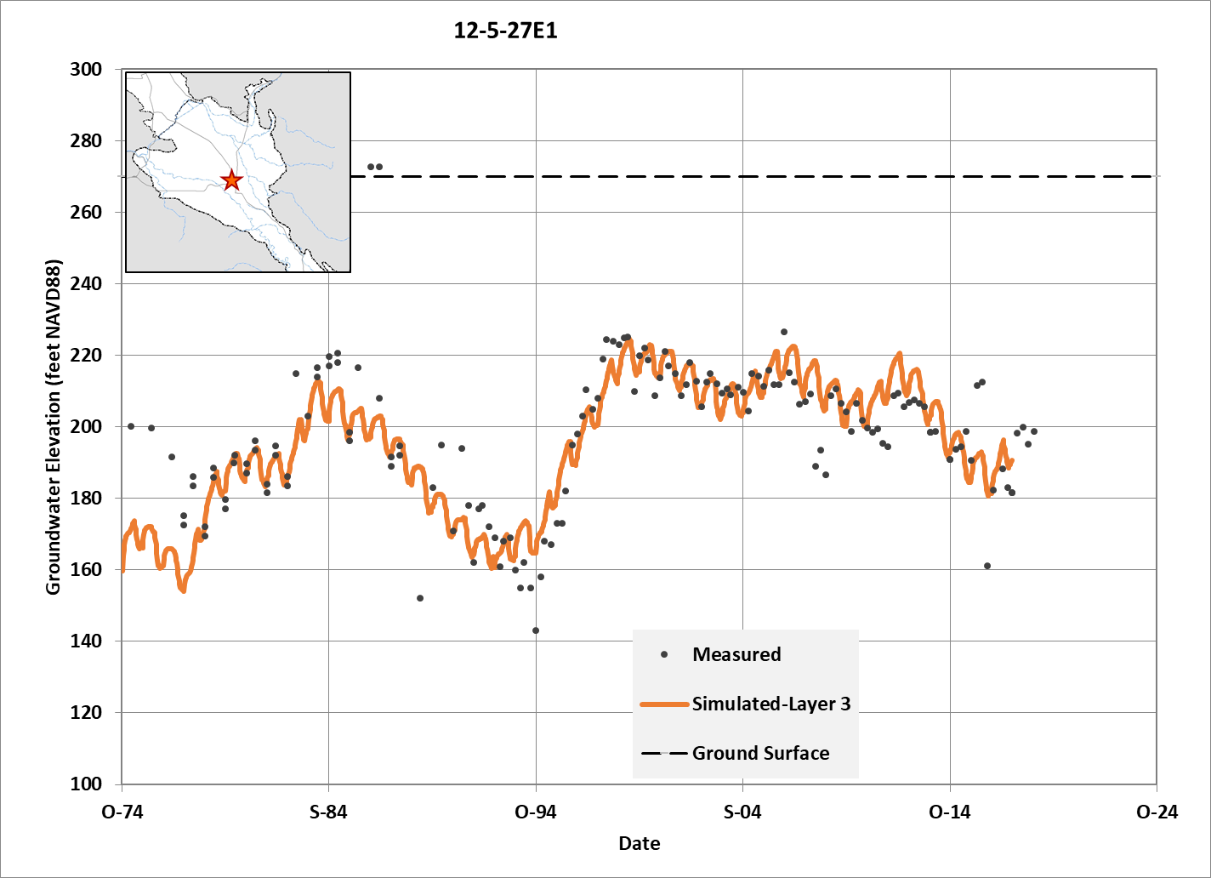
Calibrated to Measured Hydrographs
77 hydrograph wells
Notes:
This is one of the better matches between measured and simulated.

Slide 21
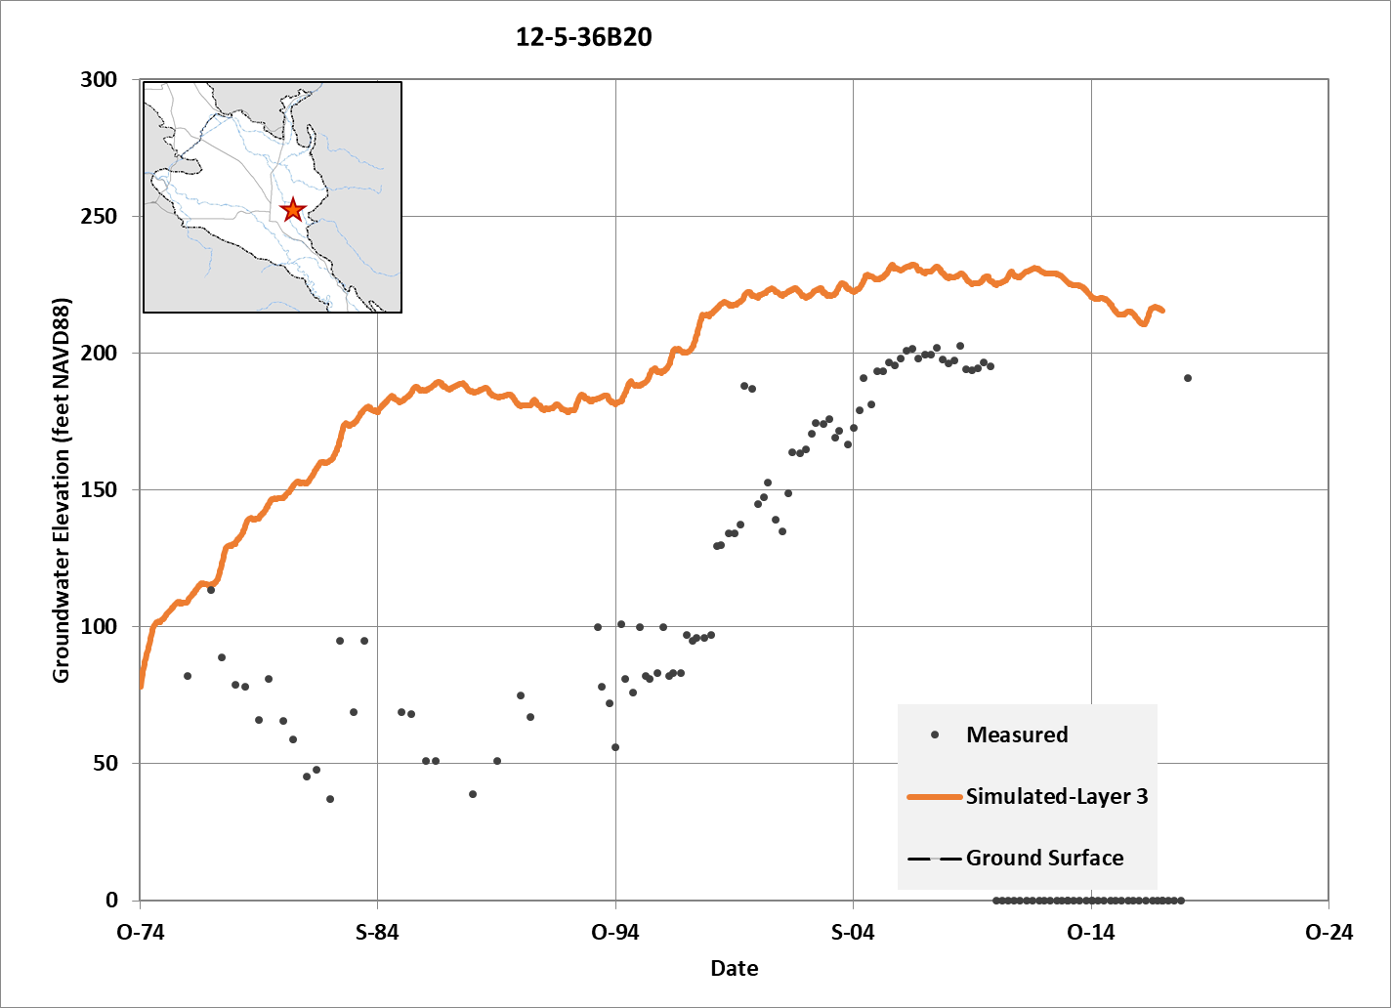
Calibrated to Measured Hydrographs
While some hydrographs are better simulated than others, the model calibration meets standard expectations.
Notes:
Some of them aren’t so good.
The residuals statistics meet expectations for well-calibrated model (RMSE is only 3% of the overall water-level range).

Slide 22
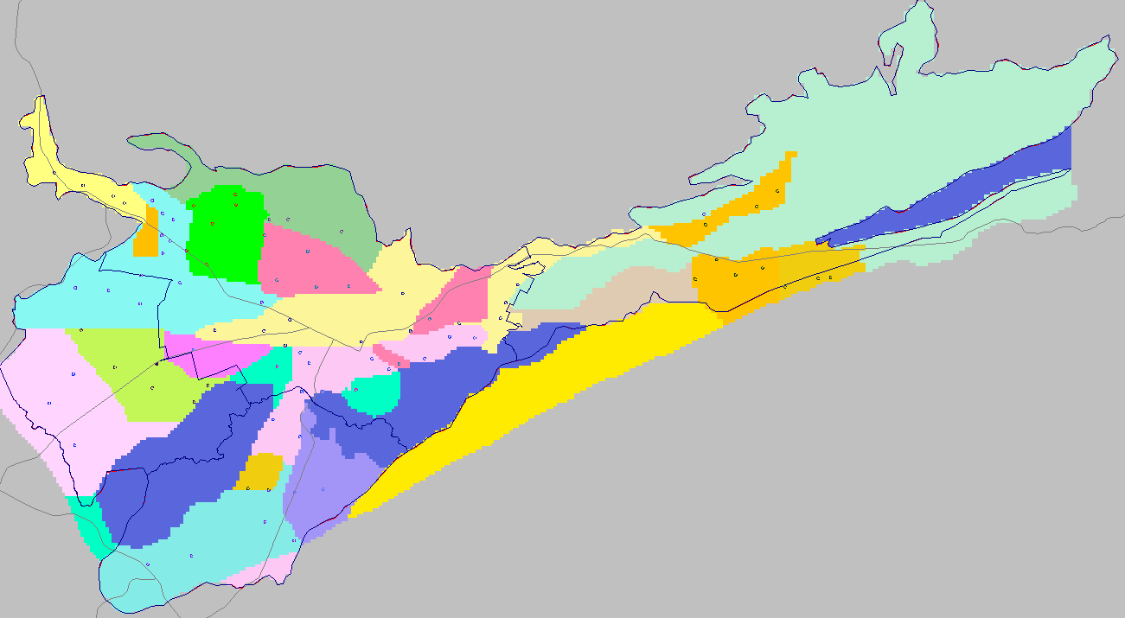
Calibrated to Measured Hydrographs
Hydraulic Conductivity and Storativity Zones
Notes:
Horizontal hydraulic conductivity ranges from 0.2 to 120 feet per day
Storativity zones same as conductivity zones.
Some variation between layers to achieve flowing wells.

Slide 23
Sustainability criteria for groundwater quality
Topics
Brief background
Undesirable results
Minimum thresholds
Measurable objectives
Management actions and monitoring
Key definitions
Notes:
We have talked about sustainability criteria for groundwater quality before, but it has been a while.
This presentation is a step-by-step process and we will cover the listed topics beginning with key background information.
The next three topics are the sustainability criteria that we need to establish.
But, when we set criteria and consider what happens if we cross a threshold, the immediate question is “what are you going to do about it?”
So see the fifth bullet on management actions and monitoring.
Lastly, SGMA has its own definitions, so we have the last page with key definitions.
I recommend that you take these out of the binder and spread them out!

Slide 24
Background on groundwater quality
Focus on TDS and nitrate; other constituents tracked, too
Ambient TDS already exceeds drinking water standards and/or Basin Plan objectives in many wells
Long-term TDS data do not show water quality deterioration
Legacy salt and nitrate loading means that groundwater quality can get worse despite reduced loading and management actions
GSA role includes
  Monitoring and reporting
  Cooperation with water quality regulatory agencies, e.g., RWQCB
  Prevention of undesirable results from basin management actions or projects
Notes:
These are important to bear in mind

Slide 25
Undesirable results: TDS and Nitrate
Undesirable results involve degradation of water quality that adversely affects beneficial uses
  TDS and nitrate: drinking water supply for municipalities and domestic users
  TDS: irrigation water quality
  Nitrate: impacts on connected surface water (algal growth, eutrophication)
Potential sources include
  Salt loading from irrigation, urban and domestic use (e.g., water softening) and need for basin outflow
  Nitrate loading from fertilizers, municipal wastewater disposal, domestic septic systems, animal wastes
Notes:
TDS and nitrate are the focus here because they are constituents that can be (are) involved in Undesirable Results, degradation of water quality that adversely affects beneficial uses, such as:
TDS and nitrate also are the focus because human activities add potential sources such as:

Slide 26
Minimum Thresholds
Minimum thresholds for water quality to be defined in terms of:
Constituents of concern determined by the GSA
    TDS
    Nitrate
    Other constituents are considered native and/or not significantly or unreasonably affected by basin management
Number of supply wells, volume of water, or an isocontour
  SBCWD monitoring is based almost entirely on supply wells and were identified to represent supply wells
Notes:
The minimum threshold is the dividing line between sustainability and undesirable results occurring throughout the basin, significant and unreasonable.
We need to define minimum thresholds and a first step is: for what?
These are identified by the GSA based on consideration of water quality data, impacts on supply wells, federal and state and local water quality standards, sources of water quality constituents and how these constituents or contaminant plumes might be affected by groundwater basin management, and what they are concerned about in the neighboring basin.
We have honed in on TDS and nitrate; SBCWD tracks a lot of constituents and regulated contaminated sites and the GSP provides documentation; and based on that other constituents like boron or arsenic or iron/manganese are native and not likely to be affected by basin management. Similarly, there are contamination sites being regulated by state agencies and we know where they are and their status.
According to GSP Regulations, we are required to define the minimum threshold in terms of number of supply wells, volume of water (like a contaminant plume) or an isocontour, for example if you could draw a line around a discrete nitrate plume or contaminant plume.
For North San Benito, where we are concerned mostly with dispersed loading, the number of supply wells works best.

Slide 27
Setting minimum thresholds
Parameter | Units | Municipal¹ | Ag²
TDS | mg/L | 500/1,000/1,500 | 450
Nitrate (as NO3) | mg/L | 45 | 100
RWQCB General Basin Plan Objectives
Basin-Specific Basin Plan Objectives
Parameter | Units | Hollister (Bolsa and San Juan) | Tres Pinos (now Southern MA)
TDS | mg/L | 1,200 | 1,000
Nitrogen (as N) | mg/L | 5 | 5
Nitrate (as NO₃) | mg/L | 22.5 | 22.5
1. Municipal levels for TDS are recommended levels
2. The Agricultural objectives for nitrate are recommended for livestock watering
Notes:
The Basin Plan already presents us with criteria that we can use for setting minimum thresholds.
General Basin Plan Objectives for TDS and nitrate
45 mg/L drinking water standard is highlighted
And Basin-specific objectives; these were based on the old subbasins, but we can easily interpret them to apply to our management areas, and provide use with minimum thresholds for TDS.
We will return to the other objectives for TDS and nitrate later.

Slide 28
Applying minimum thresholds to available data
Two data sets are available:
1. District monitored wells
Sampled to track trends, detect exceedances, support analysis of causes
About 29 wells, including the nested well
Wells in general are regionally representative and show historical trends
But some wells track local problems and have highly variable data
Notes:
SGMA requires that we use the best available data and science that we can and we are fortunate to have two distinct data sets to use:
District monitored wells
Not all wells shown, but these are indicative of how we can track trends on a frequent basis for TDS and nitrate; other constituents also tracked (see GSP and Annual Report)
While District is not responsible for local, private well problems, it does maintain monitoring to detect problems and to provide the scientific information needed to analyze and correct problems that could affect the basin and then monitor the improvement

Slide 29
Response to exceedance of minimum threshold
Short-term action is triggered when a District monitored well shows:
  Two or more consecutive exceedances at regular sampling events
  Statistically significant increasing trend over five years
Short-term monitoring actions:
  SBCWD monitoring program will be improved with more sites, dedicated wells, and rigorous protocols
  SBCWD will investigate samples/wells with an increase above minimum threshold or a significant increasing trend
Notes:
District monitored wells have been and will be used to respond to exceedances and to protect the basin.
These are actions that will be included in the GSP monitoring program.

Slide 30
Applying minimum thresholds to available data
2. Triennial update data set
Larger data set from multiple agencies compiled on triennial basis
Set of sampled wells varies over time, but more sites and widely distributed
Provides a snapshot and overview of TDS and nitrate
Constituent | Number of Wells with Nitrate or TDS Data, 2015-2017
 | Southern MA | Hollister MA | San Juan MA | Bolsa MA | Total
Nitrate (as NO3) | 19 | 121 | 81 | 35 | 256
Total Dissolved Solids | 11 | 108 | 63 | 31 | 213
Notes:
The second data set includes the data that are collected and compiled and reviewed every three years; includes District data, Ag Land monitoring and public water supply system data.

Slide 31
Definition of:
Sustainability
Unsustainability (undesirable, unreasonable, significant)
MT
How many supply wells with concentrations exceeding the minimum threshold (MT) indicate that the basin is in an unsustainable condition?
  Consider current conditions 2015-2017 as the start:
Constituent | Minimum Thresholds (from Basin Plan) | Percent Wells with Median Concentration over MT
 |  | Southern MA | Hollister MA | San Juan MA | Bolsa MA
Nitrate (as NO3) | 45 mg/L | 5% | 14% | 26% | 11%
Total Dissolved Solids (Hollister, San Juan, Bolsa) | 1,200 mg/L | --- | 24% | 46% | 26%
Total Dissolved Solids (Southern MA only) | 1,000 mg/L | 55% | --- | --- | ---

Slide 32
Definition of:
Sustainability
Unsustainability (undesirable, unreasonable, significant)
DRAFT
MT
Apply the minimum threshold to triennial data.
The definition for nitrate* is
a statistically significant increase, relative to current conditions, in the median percentage of wells exceeding the minimum threshold (Basin Plan Objective) for nitrate, as indicated in the triennial update.
    and
  a statistically significant increasing trend in the nitrate concentration in 15% or more of the District monitored wells over a five year period.
This makes good use of District monitored well data.
*Use the same definition for Total Dissolved Solids.

Slide 33
Setting measurable objectives
RWQCB General Basin Plan Objectives
Basin-Specific Basin Plan Objectives
Parameter | Units | Municipal¹ | Ag²
TDS | mg/L | 500/1,000/1,500 | 450
Nitrate (as NO3) | mg/L | 45 | 100
Parameter | Units | Hollister (Bolsa and San Juan) | Tres Pinos (now Southern MA)
TDS | mg/L | 1,200 | 1,000
Nitrogen (as N) | mg/L | 5 | 5
Nitrate (as NO₃) | mg/L | 22.5 | 22.5
1. Municipal levels for TDS are recommended levels
2. The Agricultural objectives for nitrate are recommended for livestock watering
Notes:
Measurable objectives are where we would like to be; an objective to reach for.
For TDS, we indicate that concentrations above 1,000 or 1,200 are undesirable; with that 500 mg/L would be good.
For Nitrate, the RWQCB has provided us an objective of 22.5 mg/L, half the drinking water standard, and having concentrations below that would be good.

Slide 34
Monitoring and management actions
Short-term monitoring actions
  Monitoring program will involve more sites, vertical monitoring, consistent protocols
  Investigate samples/wells with an increase above minimum threshold or a trend
These short-term actions will inform long-term actions
Long term management actions
  Increase CVP percolation, Managed Aquifer Recharge of local surface and stormwater
  Improve monitoring program
  Continue SNMP and ILRP
  Maintain groundwater outflow
  Cooperate with County on OWTS and wastewater treatment/disposal
  Continue and expand water softener conversion to cartridge type
  Encourage use of non-gypsum soil amendments
  Improve irrigation practices to reduce loading; e.g., decrease sprinkler spray evaporation
Notes:
the GSA can undertake short term actions to protect quality and provide more understanding
And long term management actions to protect and improve quality

Slide 35
Key definitions
“Measurable objectives” refer to specific, quantifiable goals for the maintenance or improvement of specified groundwater conditions that have been included in an adopted Plan to achieve the sustainability goal for the basin.
“Minimum threshold” refers to a numeric value for each sustainability indicator used to define undesirable results.
Undesirable results occur when significant and unreasonable effects for any of the sustainability indicators are caused by groundwater conditions occurring throughout the basin. The description of undesirable results shall include the following:
The cause of groundwater conditions occurring throughout the basin that would lead to or has led to undesirable results based on information described in the basin setting, and other data or models as appropriate.
The criteria used to define when and where the effects of the groundwater conditions cause undesirable results for each applicable sustainability indicator. The criteria shall be based on a quantitative description of the combination of minimum threshold exceedances that cause significant and unreasonable effects in the basin.
Potential effects on the beneficial uses and users of groundwater, on land uses and property interests, and other potential effects that may occur or are occurring from undesirable results.

Slide 36
GSP Overview, Workshops, and
TAC Meetings
2021
Plan Development
Adoption hearing
Draft GSP workshop
Management Actions / Monitoring
2020
Implementation workshop
Sustainability Criteria
Actions workshop
Criteria workshop
Management Areas / Water Budgets
2019
Water budget workshop
February 25 2020
Hydrogeologic Conceptual Model / Groundwater
HCM-GW Conditions
workshop June 18 2019
Data Compilation / Data
Management System
Kickoff workshop Nov 7 2018
2018
Plan Area / Institutional Setting

Slide 37
Next Steps
SBCWD Board of Director’s Meeting: Annual Report with Water Quality Update | January 13, 2020
Public Workshop No. 3 Water Budget | February 25, 2020
TAC Meeting No. 8 Sustainability Criteria | April 29, 2020

