Slide 1
Technical Advisory Committee
San Benito County Water District
Groundwater Sustainability Agency
September 29, 2020 2:00-4:00
Join Zoom Meeting
https://zoom.us/j/98054432455?pwd=TkpyTUl6L3dPM0hGaTZRSWgzSFVUZz09
Or dial: +1 669 900 9128 US (San Jose)
Meeting ID: 980 5443 2455
Passcode: 251488

Slide 2
Agenda
Roll call
GSP overview
Monitoring network and reporting
Description of monitoring network and data gaps
Measuring agricultural pumping
Summary of data gaps and next steps
Upcoming meetings

Slide 3
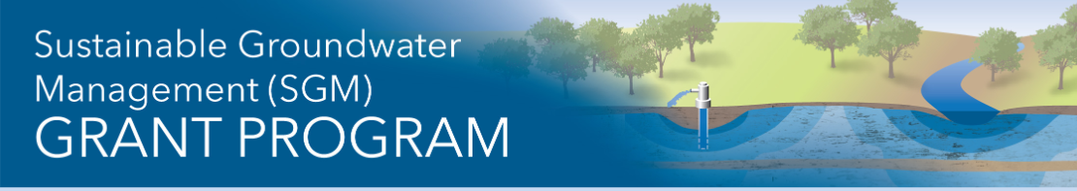
GSP Overview
2021
Plan Development
Management Actions / Monitoring
Round 3 Effort
DWR SGM funding
Initiated in June 2020
Concurrent with GSP
Two main tasks
2020
TAC Meetings
Sustainability Criteria
Management Areas / Water Budgets
Install dedicated Monitoring Wells
Evaluate feasibility of Managed Aquifer Recharge (MAR)
2019
Hydrogeologic Conceptual Model / Groundwater
Data Compilation / Data
Management System
2018
Plan Area / Institutional Setting

Slide 4
Monitoring Network Objectives
Build on the existing monitoring and available data
Expand to better represent all Management Areas
Provide better data to guide management
Monitor groundwater conditions relative to sustainability criteria
Identify and track potential impacts on groundwater users/uses
Better communicate the state of the basin.

Slide 5
Annual Monitoring and Reporting
SBCWD Annual Groundwater Reports have been prepared for decades
SGMA has specific requirements for annual reporting
  Groundwater elevation contour maps and hydrographs
  Groundwater extraction volume by use sector with map
  Surface water supply for recharge or in-lieu use
  Total water use by use sector and source
  Change in groundwater in storage maps, graphs
  Description of progress (where other sustainability criteria can be addressed)
Technical contents are similar. Timing differs (January or April report).

Slide 6
Five-Year GSP Updates
GSAs required to evaluate GSP every five years
Describe current conditions relative to sustainability criteria
Describe implementation and effects
Reconsider GSP elements (basin setting, criteria, MAs, etc.)
Evaluate basin setting for changes (e.g., water use)
Assess monitoring network, data gaps, new data, new facilities

Slide 7
Some Five-Year Updates are underway
Alternative GSP Plans submitted by January 2017
Five Year Updates are due by January 2022
Scopes include response to DWR comments and more, for example:
Hydrogeologic cross-sections
Evaluation of GDEs, salt and nutrient loading, etc.
Monitoring program improvements
Numerical model update and calibration

Slide 8





Description of Monitoring Network
Organized for tracking Sustainability Criteria*
Chronic lowering of groundwater levels
Depletion of interconnected surface water
Land subsidence
Degraded water quality
Reduction of groundwater in storage
*No seawater intrusion

Slide 9
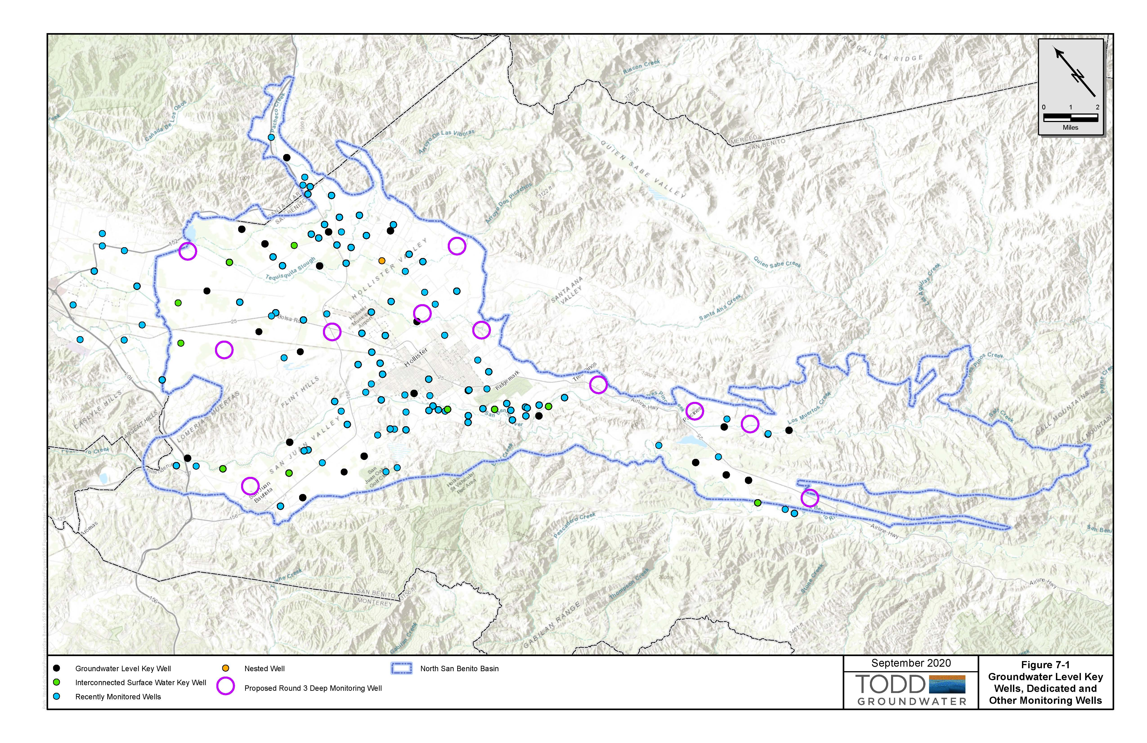
Groundwater Levels Monitoring
Planned improvements
Track Key Wells
New dedicated wells
Add coverage across all MAs
Add complete well information and cross-reference in DMS (Data Management System)
Obtain more data on vertical gradients

Slide 10
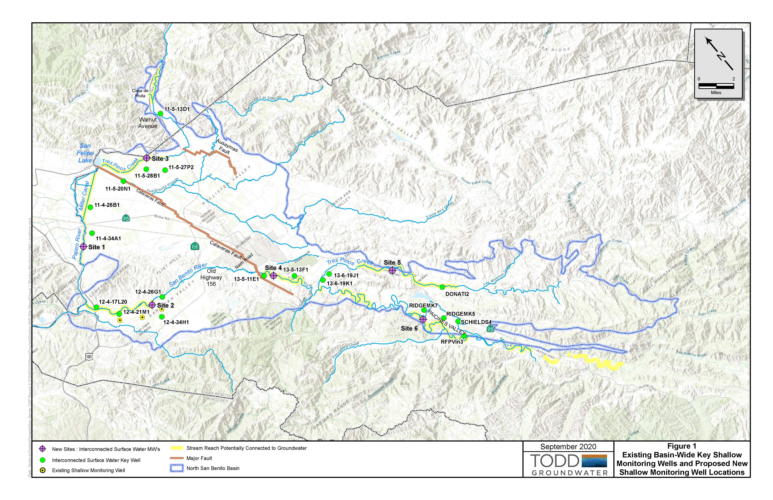
Interconnected Surface Water: Key Wells
A new program
Track Key Wells
Install and monitor new shallow dedicated wells
Also, provide complete well information in DMS including unique Well IDs
Consider investigations, e.g., steelhead passage

Slide 11
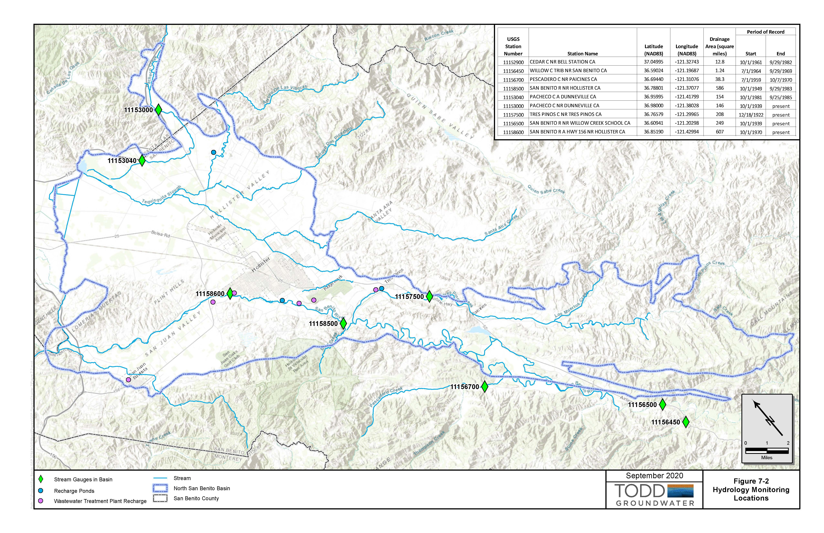
Hydrology Monitoring
Potential improvements
Four permanent gages
Additional stream gages would support numerical modeling and evaluation of groundwater-surface water interactions
Permanent USGS gages are costly
√
√
√
√

Slide 12
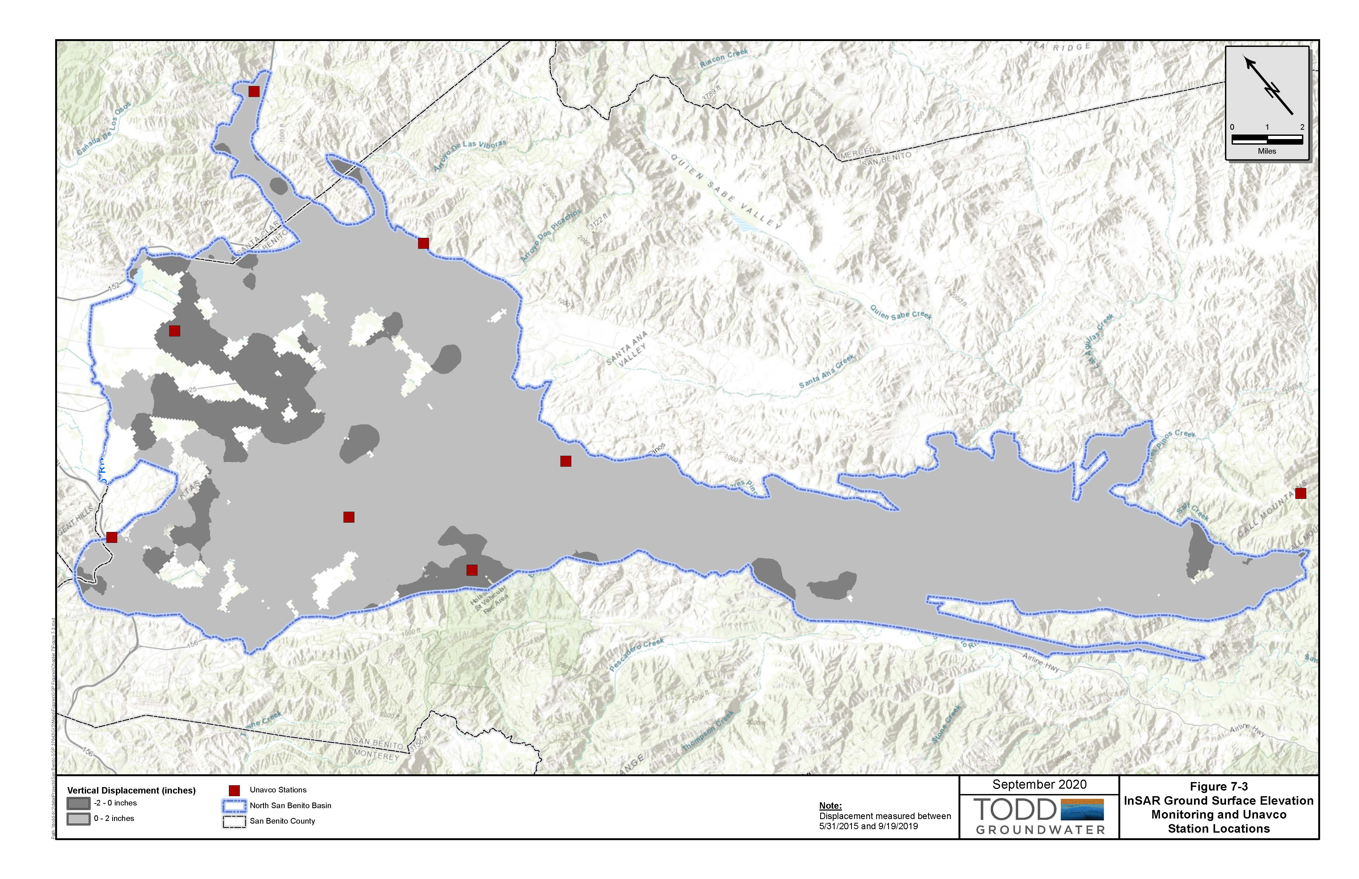
Land Subsidence Monitoring
A new program
Download UNAVCO and InSAR data annually
Review annually for significant changes
In-depth analysis of data on subsidence, levels, pumping for Five-Year Update

Slide 13
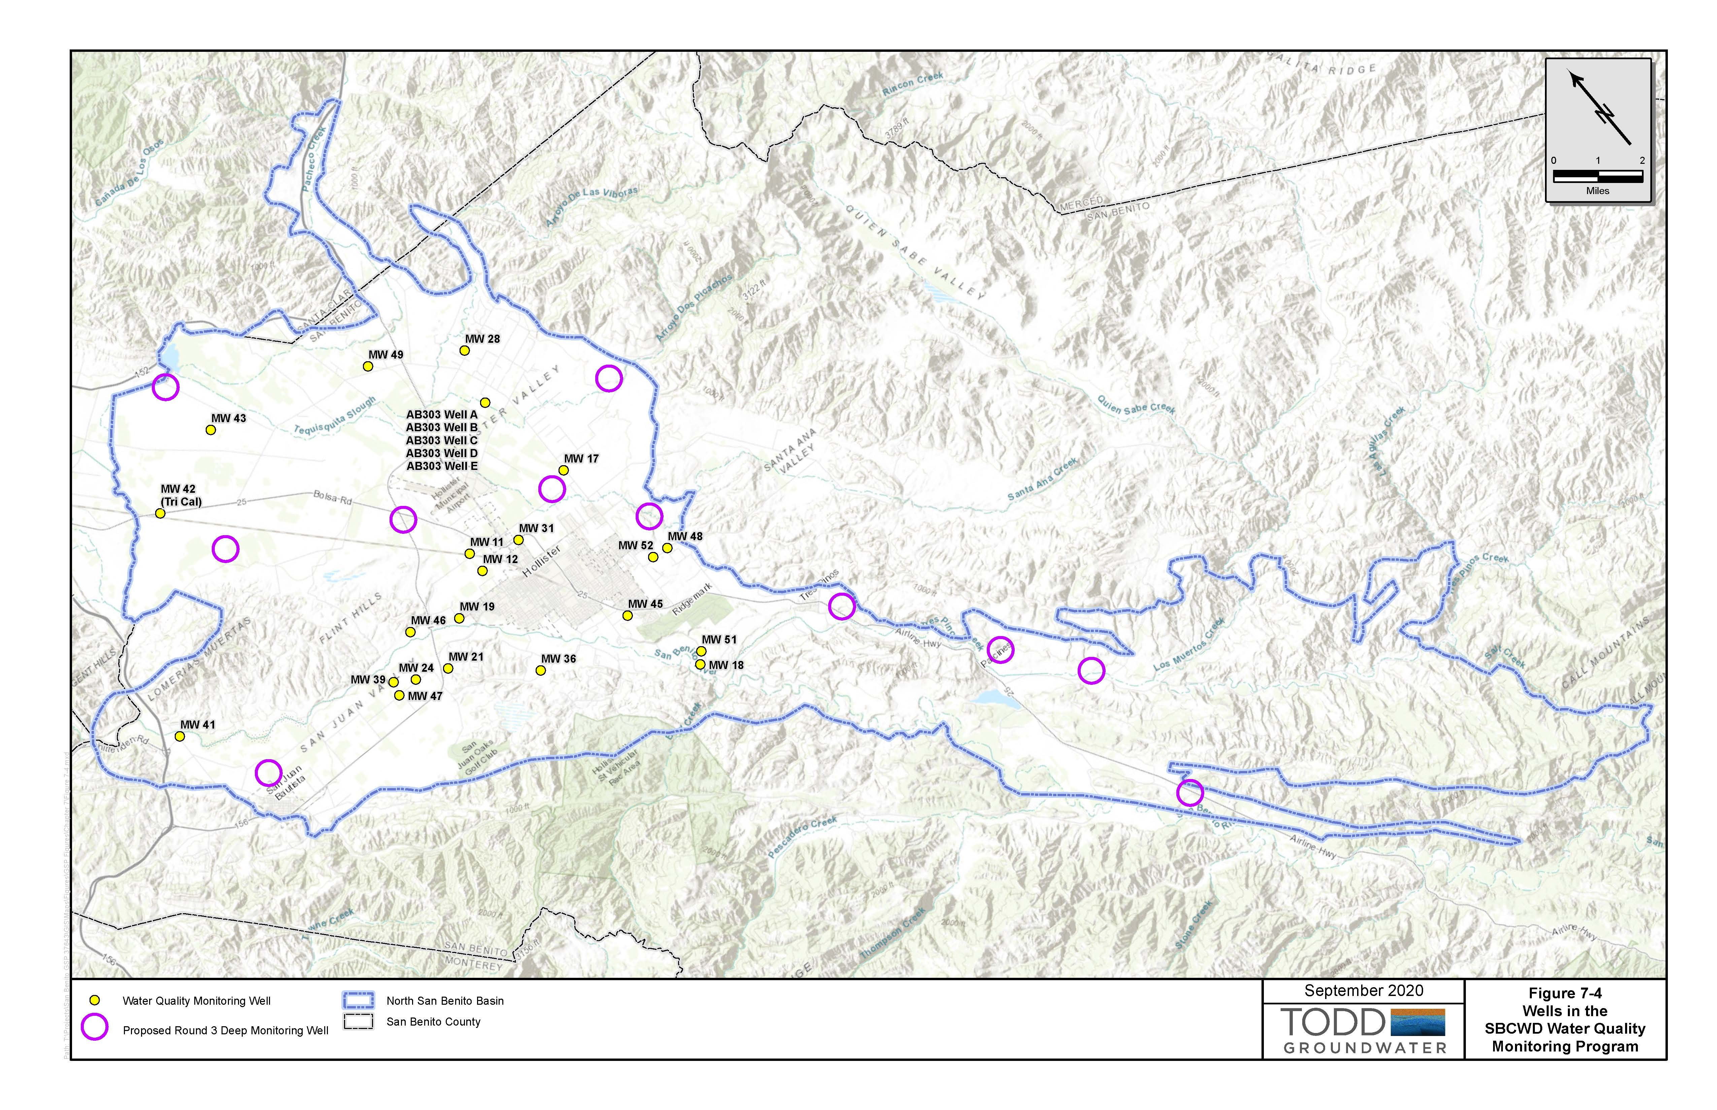
SBCWD Groundwater Quality Monitoring
Planned improvements
Track Key Wells
New dedicated wells
Continue Triennial Updates for all data
Consider additional analytes for geochemical evaluation
Obtain more data on vertical gradients

Slide 14
Change in groundwater storage
Rainfall
Reference ET (ET₀)
Stream flow- USGS gages
Stream flow- misc. flow measurements
CVP deliveries- Agricultural
CVP deliveries- Municipal
Reservoir water budgets- Hernandez, Paicines
Reservoir releases-percolation
CVP diversions to percolation ponds
Wastewater pond water budgets
Wastewater percolation
Recycled water use
Crop patterns- GIS acreage
Municipal water use by sector
  Involves tracking multiple water budget variables
  To be computed annually with numerical model for each MA
  Primary data gap is lack of reliable measurements of non-de minimis pumping (e.g., agriculture, industry)

Slide 15
Measuring pumping
Objectives:
All extractions (except for de minimis domestic, <2 AFY) required for annual reporting
  General location and volume
  Need to describe method and its accuracy
Agricultural pumping is major data gap affecting water budget analysis and numerical model
Pumping measurements can provide potential basis for accurate and equitable fees for the entire basin

Slide 16
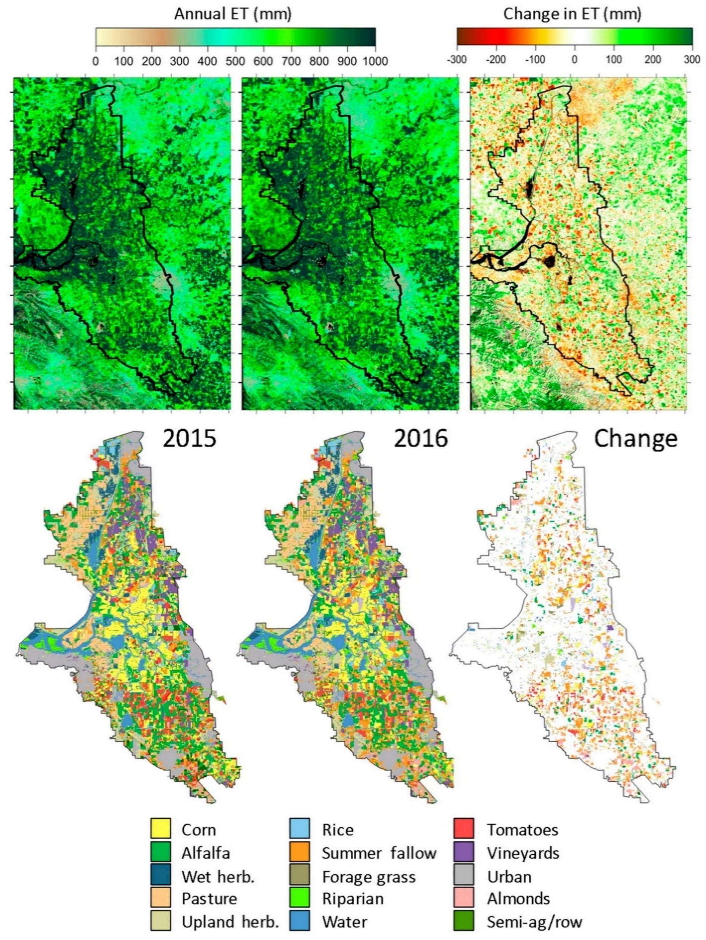
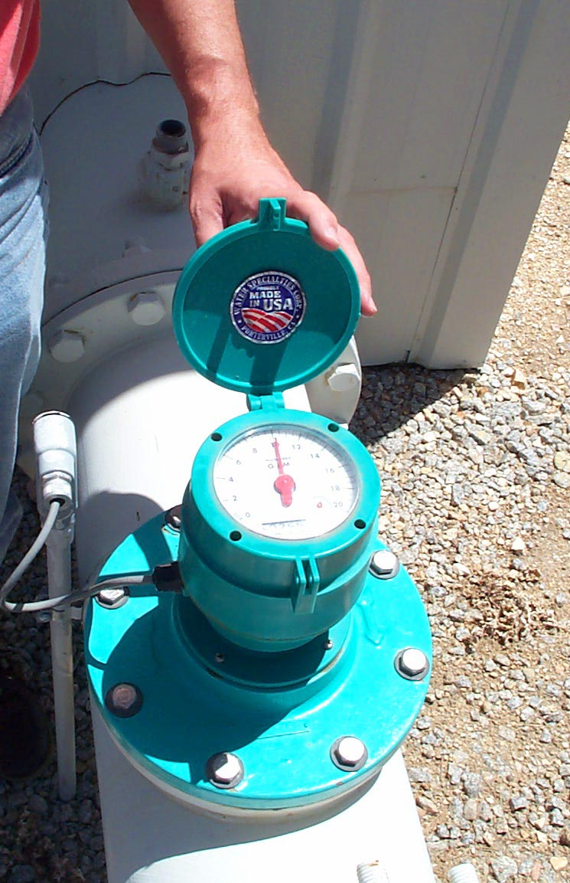
  Methods for Measuring Agricultural Pumping
    A GSA may use any reasonable method to determine groundwater extraction
    Land use acreage / water demand estimation currently used in Annual Reports
    Power meter readings currently used in Zone 6
    In-line meter with self-reporting / GSA checking
      Remote sensing
Utilizes satellite imagery, land use, field measurements
Mapped at field scale with high resolution
Monthly estimates of ET that accounts for crop age and multi-cropping
Can be calibrated to measured production
Being used in Central Valley by large water agencies
16

Slide 17
  Methods for measuring non-de minimis pumping
    Considerations:
    Accuracy and reliability relative to purpose
    Costs and allocation of cost, GSA and well owner
    Feasibility of implementation, timing to implement
    Ease of ongoing data collection, maintenance
    Well owner acceptability and cooperation
    Other benefits? Other costs?
17

Slide 18
Some initial considerations
Method | Pros? | Cons?
Historical/current estimation based on land use/crop acreage x water use factor | Historical method, accepted | Relatively inaccurate Requires SBCWD staff time, access to power meter
Historical/current Zone 6, hours of pumping x avg discharge rate | Method in use Minimal well owner obligations | Relatively inaccurate SBCWD staff/consultant time
In-line metering SBCWD-approved meters, vendors | Relatively accurate with regular checking/maintenance Understood by well owners Growers have direct access to data | May not be readily accepted by owners, slow implementation. Requires well access, installation Meter cost-well owner? SBCWD staff time, access to meter
Satellite land use mapping and measurement of ET | Accurate Minimal SBCWD field staff time Minimal need to access private property Frequent information on crop type and water demand field by field | New technology means need to inform/engage landowners Potential cost

Slide 19
Summary of Data Gaps
 | Insufficient Sites | Unreliable Sites | Access Issues | Location | Local Issues
Levels and Quality | √ | √ | √ | Network focused on Zone 6. Reliance on private production wells. Insufficient dedicated monitoring wells. Insufficient data exist on vertical gradients. | Use of production wells; some lack well construction information, unique ID, reference point, and/or access issues. Need additional quality analytes. Need basin-wide funding.
Stream flow | √ |  |  | Only five active gages; gage lacking on Upper Tres Pinos Creek. | High cost of installing, maintaining gages.
Ground water extraction | √ | √ | √ | Current power metering method is limited to Zone 6; need for consistent accurate method for entire basin. | Need for basin-wide funding and implementation of single, consistent method.
Shallow levels | √ |  |  | Shallow groundwater monitoring wells lacking along stream reaches with potential surface water-groundwater connection. | See levels and quality above.

Slide 20
Steps to Fill Data Gaps
Implement basin-wide funding mechanism for monitoring throughout MAs
  Parcel-based in short term
  Groundwater extraction in long term
Improve the well inventory as part of the data management system (DMS)
  Implement unique well identification program
  Document well information in a GIS-linked database
  Cross-reference monitoring sites in DMS
Enhance water quality sampling program
Evaluate monitoring network and programs (levels and quality) as ongoing, adaptive effort
Evaluate and implement accurate method to measure non-de minimis extraction

Slide 21
Next Steps
Administrative Draft Section 7 is for your information: review and commentary is not required
Topics for Next TAC meeting
  Projects and Management Actions

Slide 22
Stay tuned
SBCWD Board of Director’s Meeting | October 28, 2020 5:00pm
Next TAC Meeting: Projects and Management Actions | November 4, 2020
Public Workshop No. 3 Management Actions | TBA December 2020

