Slide 1
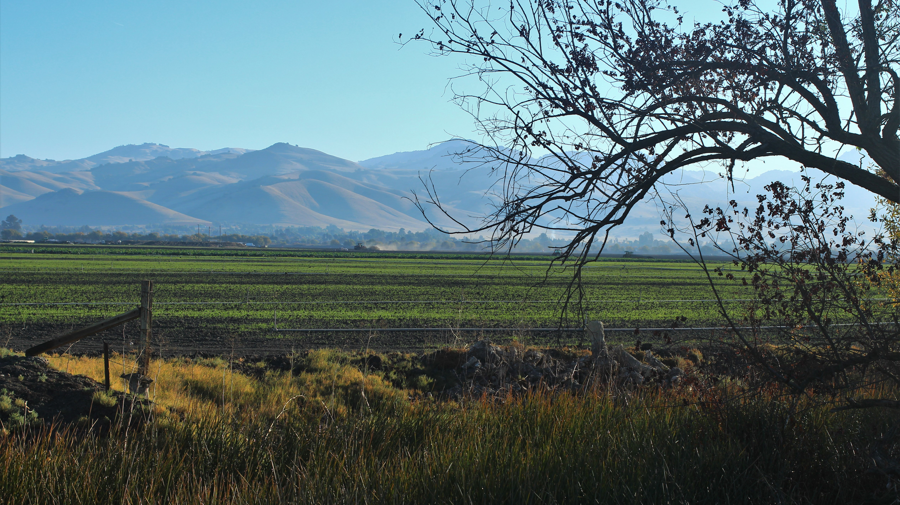


Annual Groundwater Report 2020
San Benito County Water District
Todd Groundwater
Maureen Reilly, PE
Iris Priestaf, PhD

Slide 2
Agenda
Introduction: 2020 at a glance
Geographic Area
Basin Conditions
Water Use
Looking Ahead

Slide 3
2020 at a glance
Generally stable conditions
  Slightly below normal rainfall –water levels declined
  CVP allocation:
Total water use stable
  Groundwater is 54 percent of supply in Zone 6
  Recycled water at 1 percent
Monitoring and data are being evaluated for SGMA
USBR Water Year | Agriculture | M&I
March 2019 - February 2020 | 75% | 100%
March 2020 - February 2021 | 20% | 70%

Slide 4
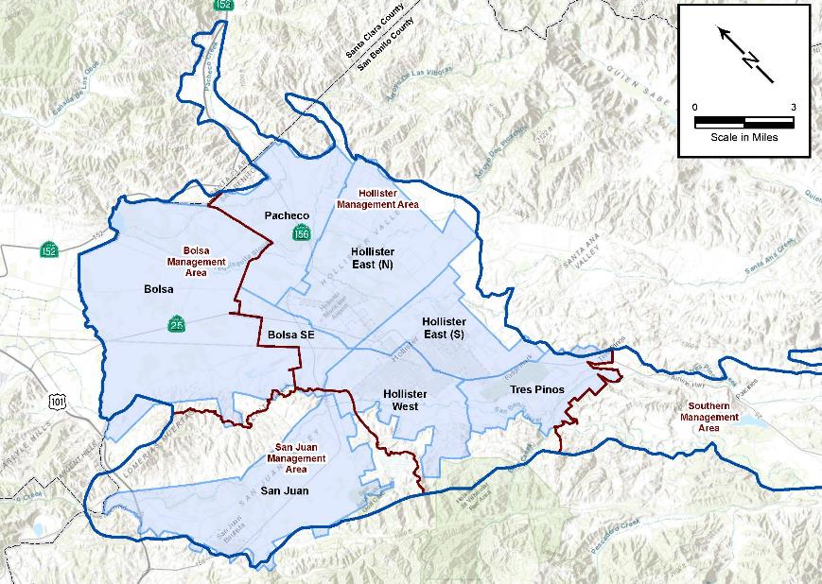
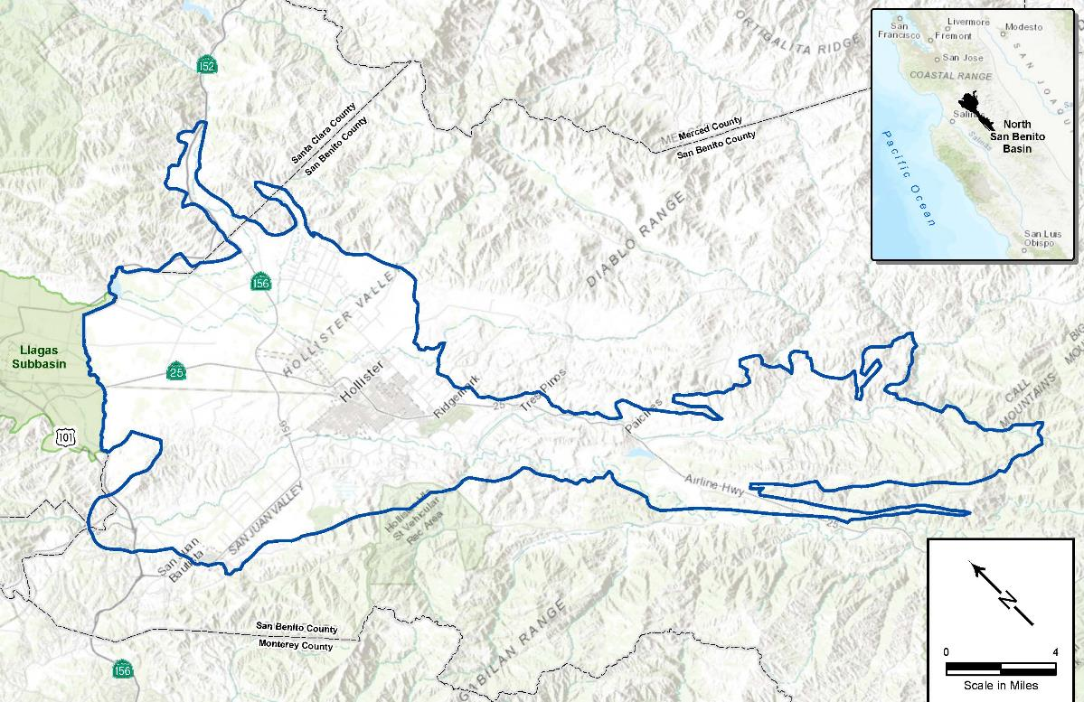
Geographic Area
Annual Report focuses on Zone 6
GSP and future Annual Reports address North San Benito Groundwater Basin

Slide 5
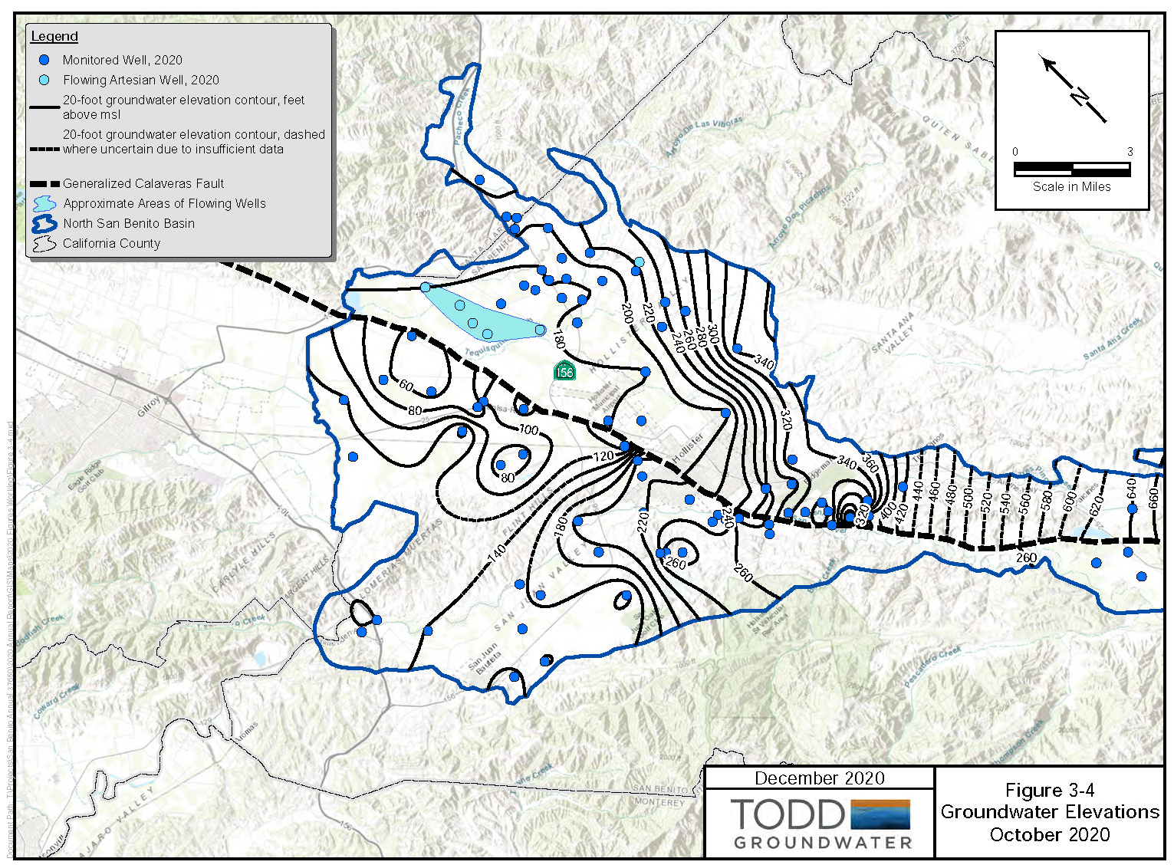
Basin Conditions:
Groundwater Levels
Monitoring network being improved
100 wells
Continue to add new wells

Slide 6
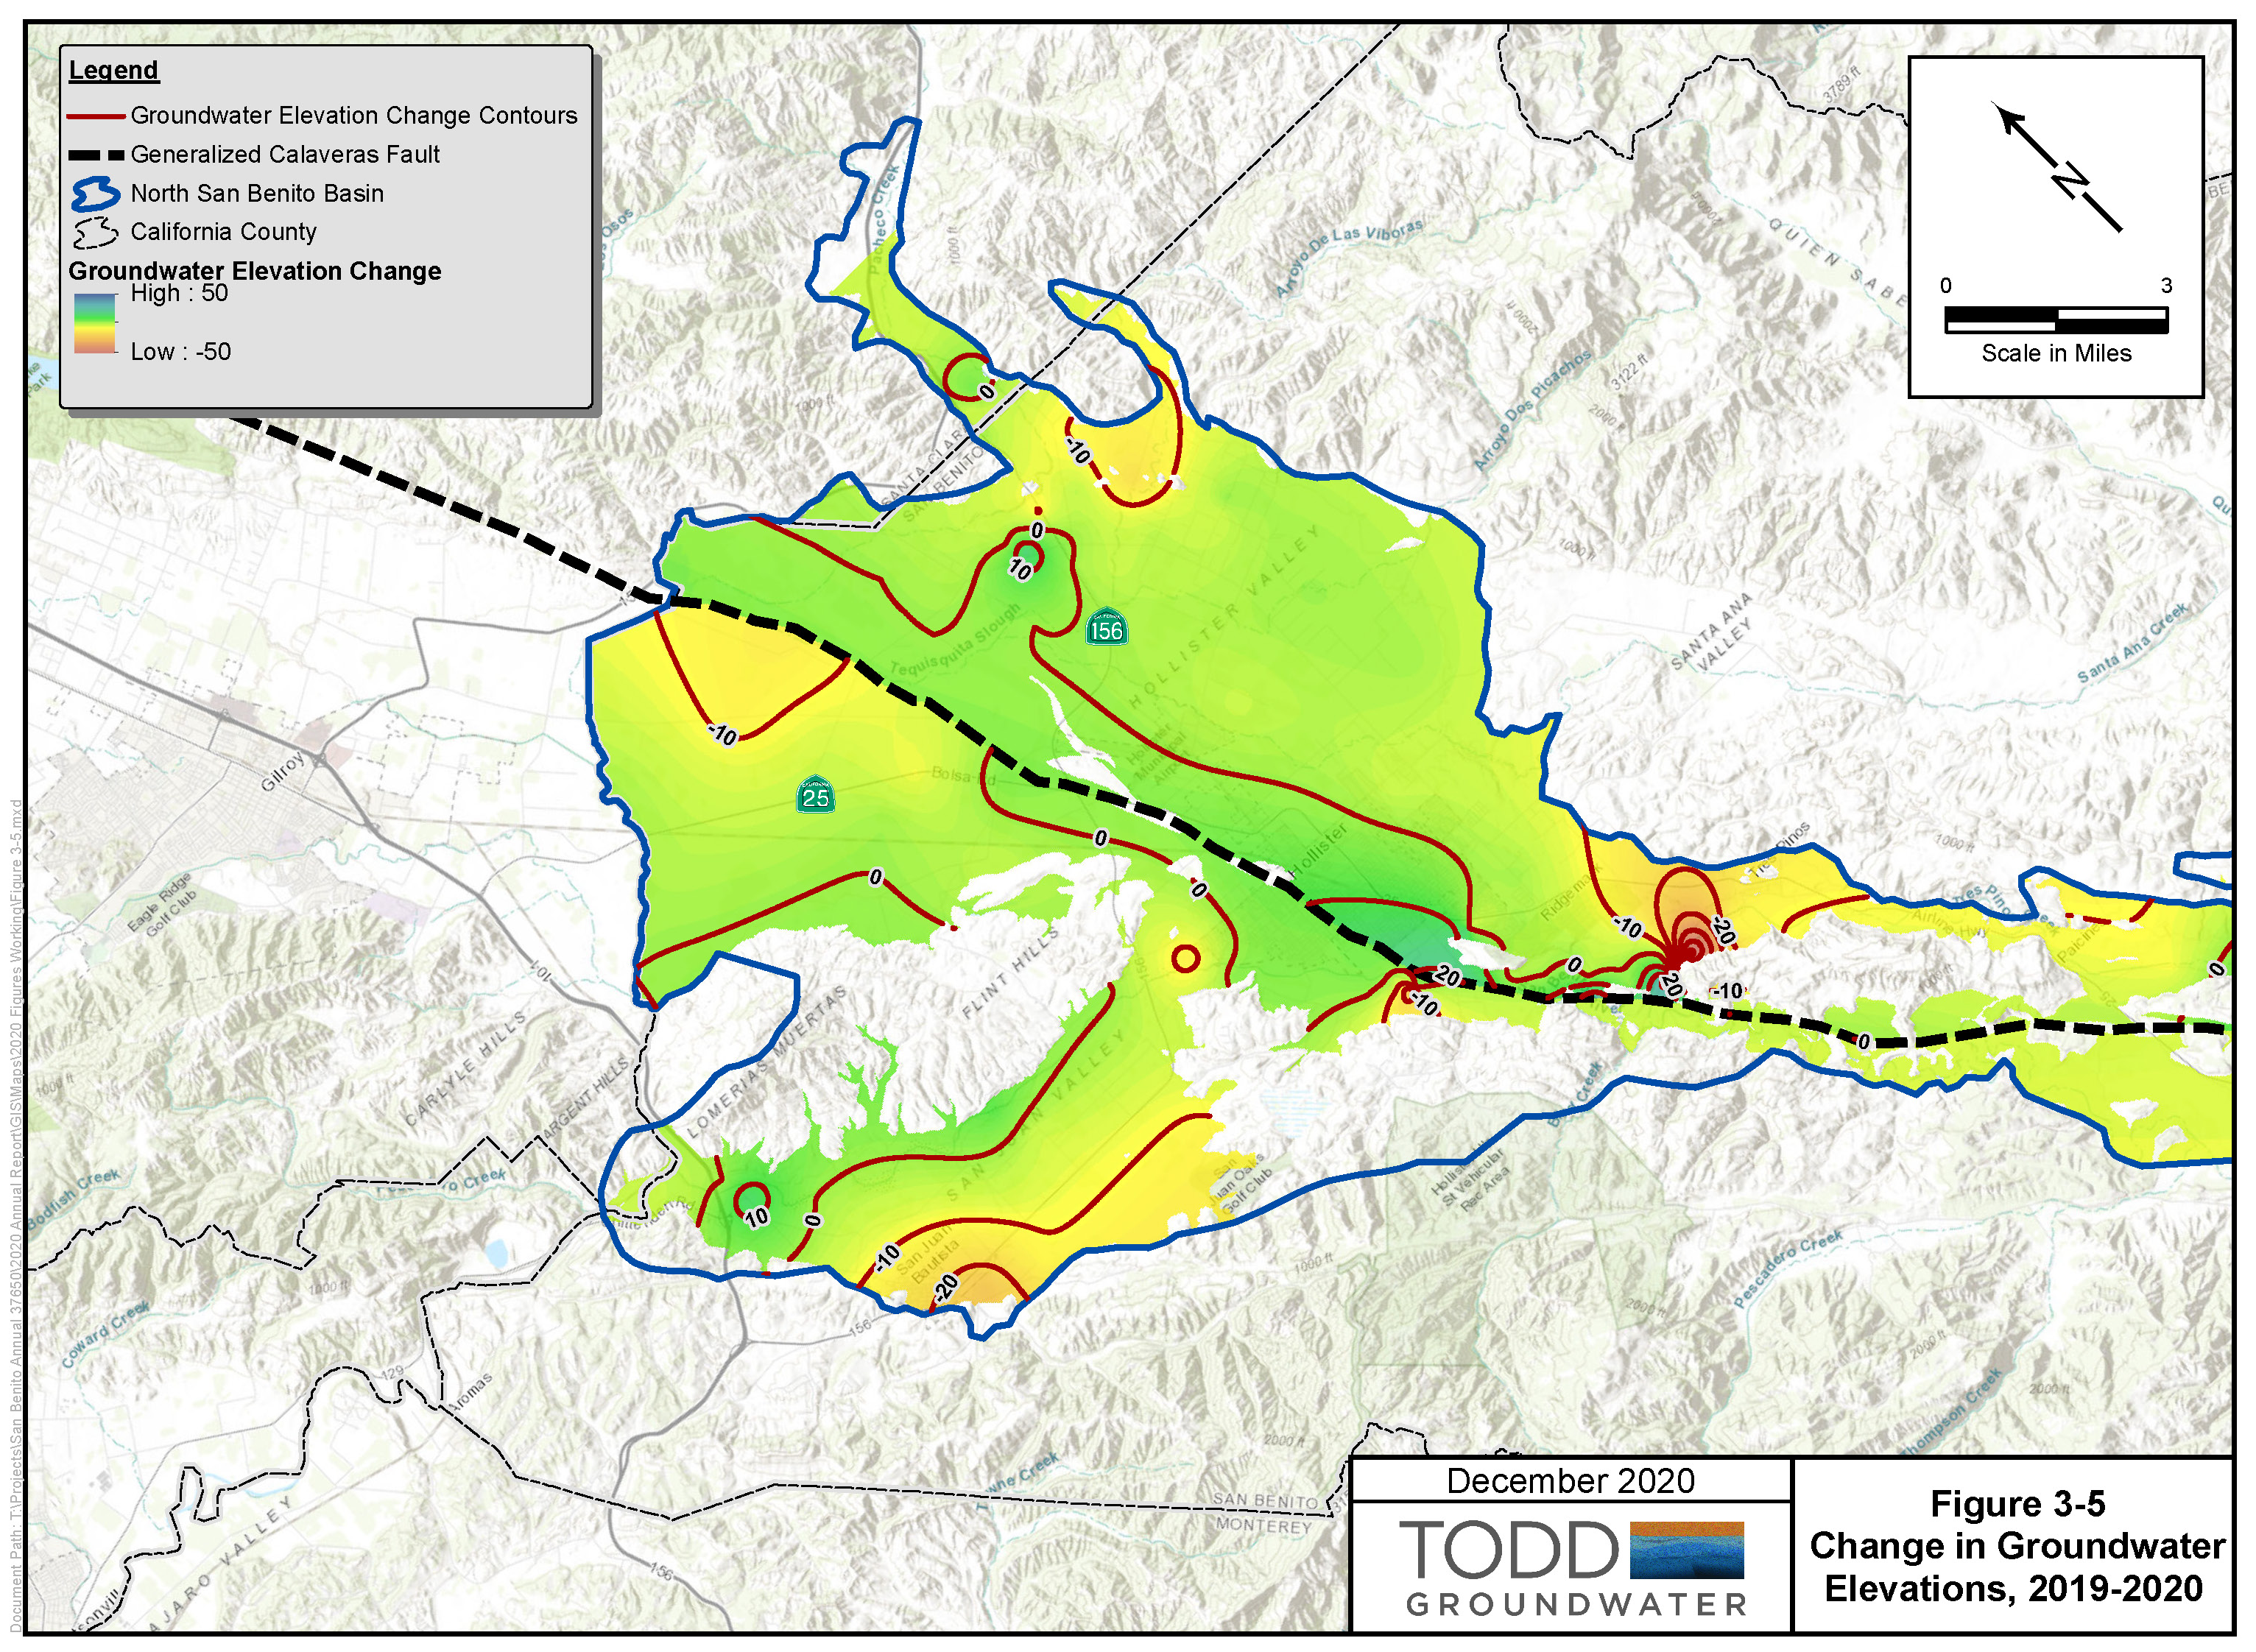
Change in Levels
2019 to 2020

Slide 7
Groundwater storage decreased slightly in 2020

Slide 8
Annual Zone 6 Water Use by Source
Total water use remained at about 38,000 acre-feet
  Increased M&I demand for CVP
  Groundwater use was 54 percent of total supply
  Recycled water decreased slightly last year
  Ag recycled water use up to 170% since 2016

Slide 9
Volume of Percolation, afy, 1994-2020
Increased CVP percolation into off-stream basins

Slide 10
Plan Development
GSP Overview
Management / Plan Components
Management Actions / Monitoring
Sustainability Criteria
Policy Components
Management Areas / Water Budgets
Technical Components
Hydrogeologic Conceptual Model / Groundwater
Data Compilation / Data
Management System
Plan Area / Institutional Setting

Slide 11
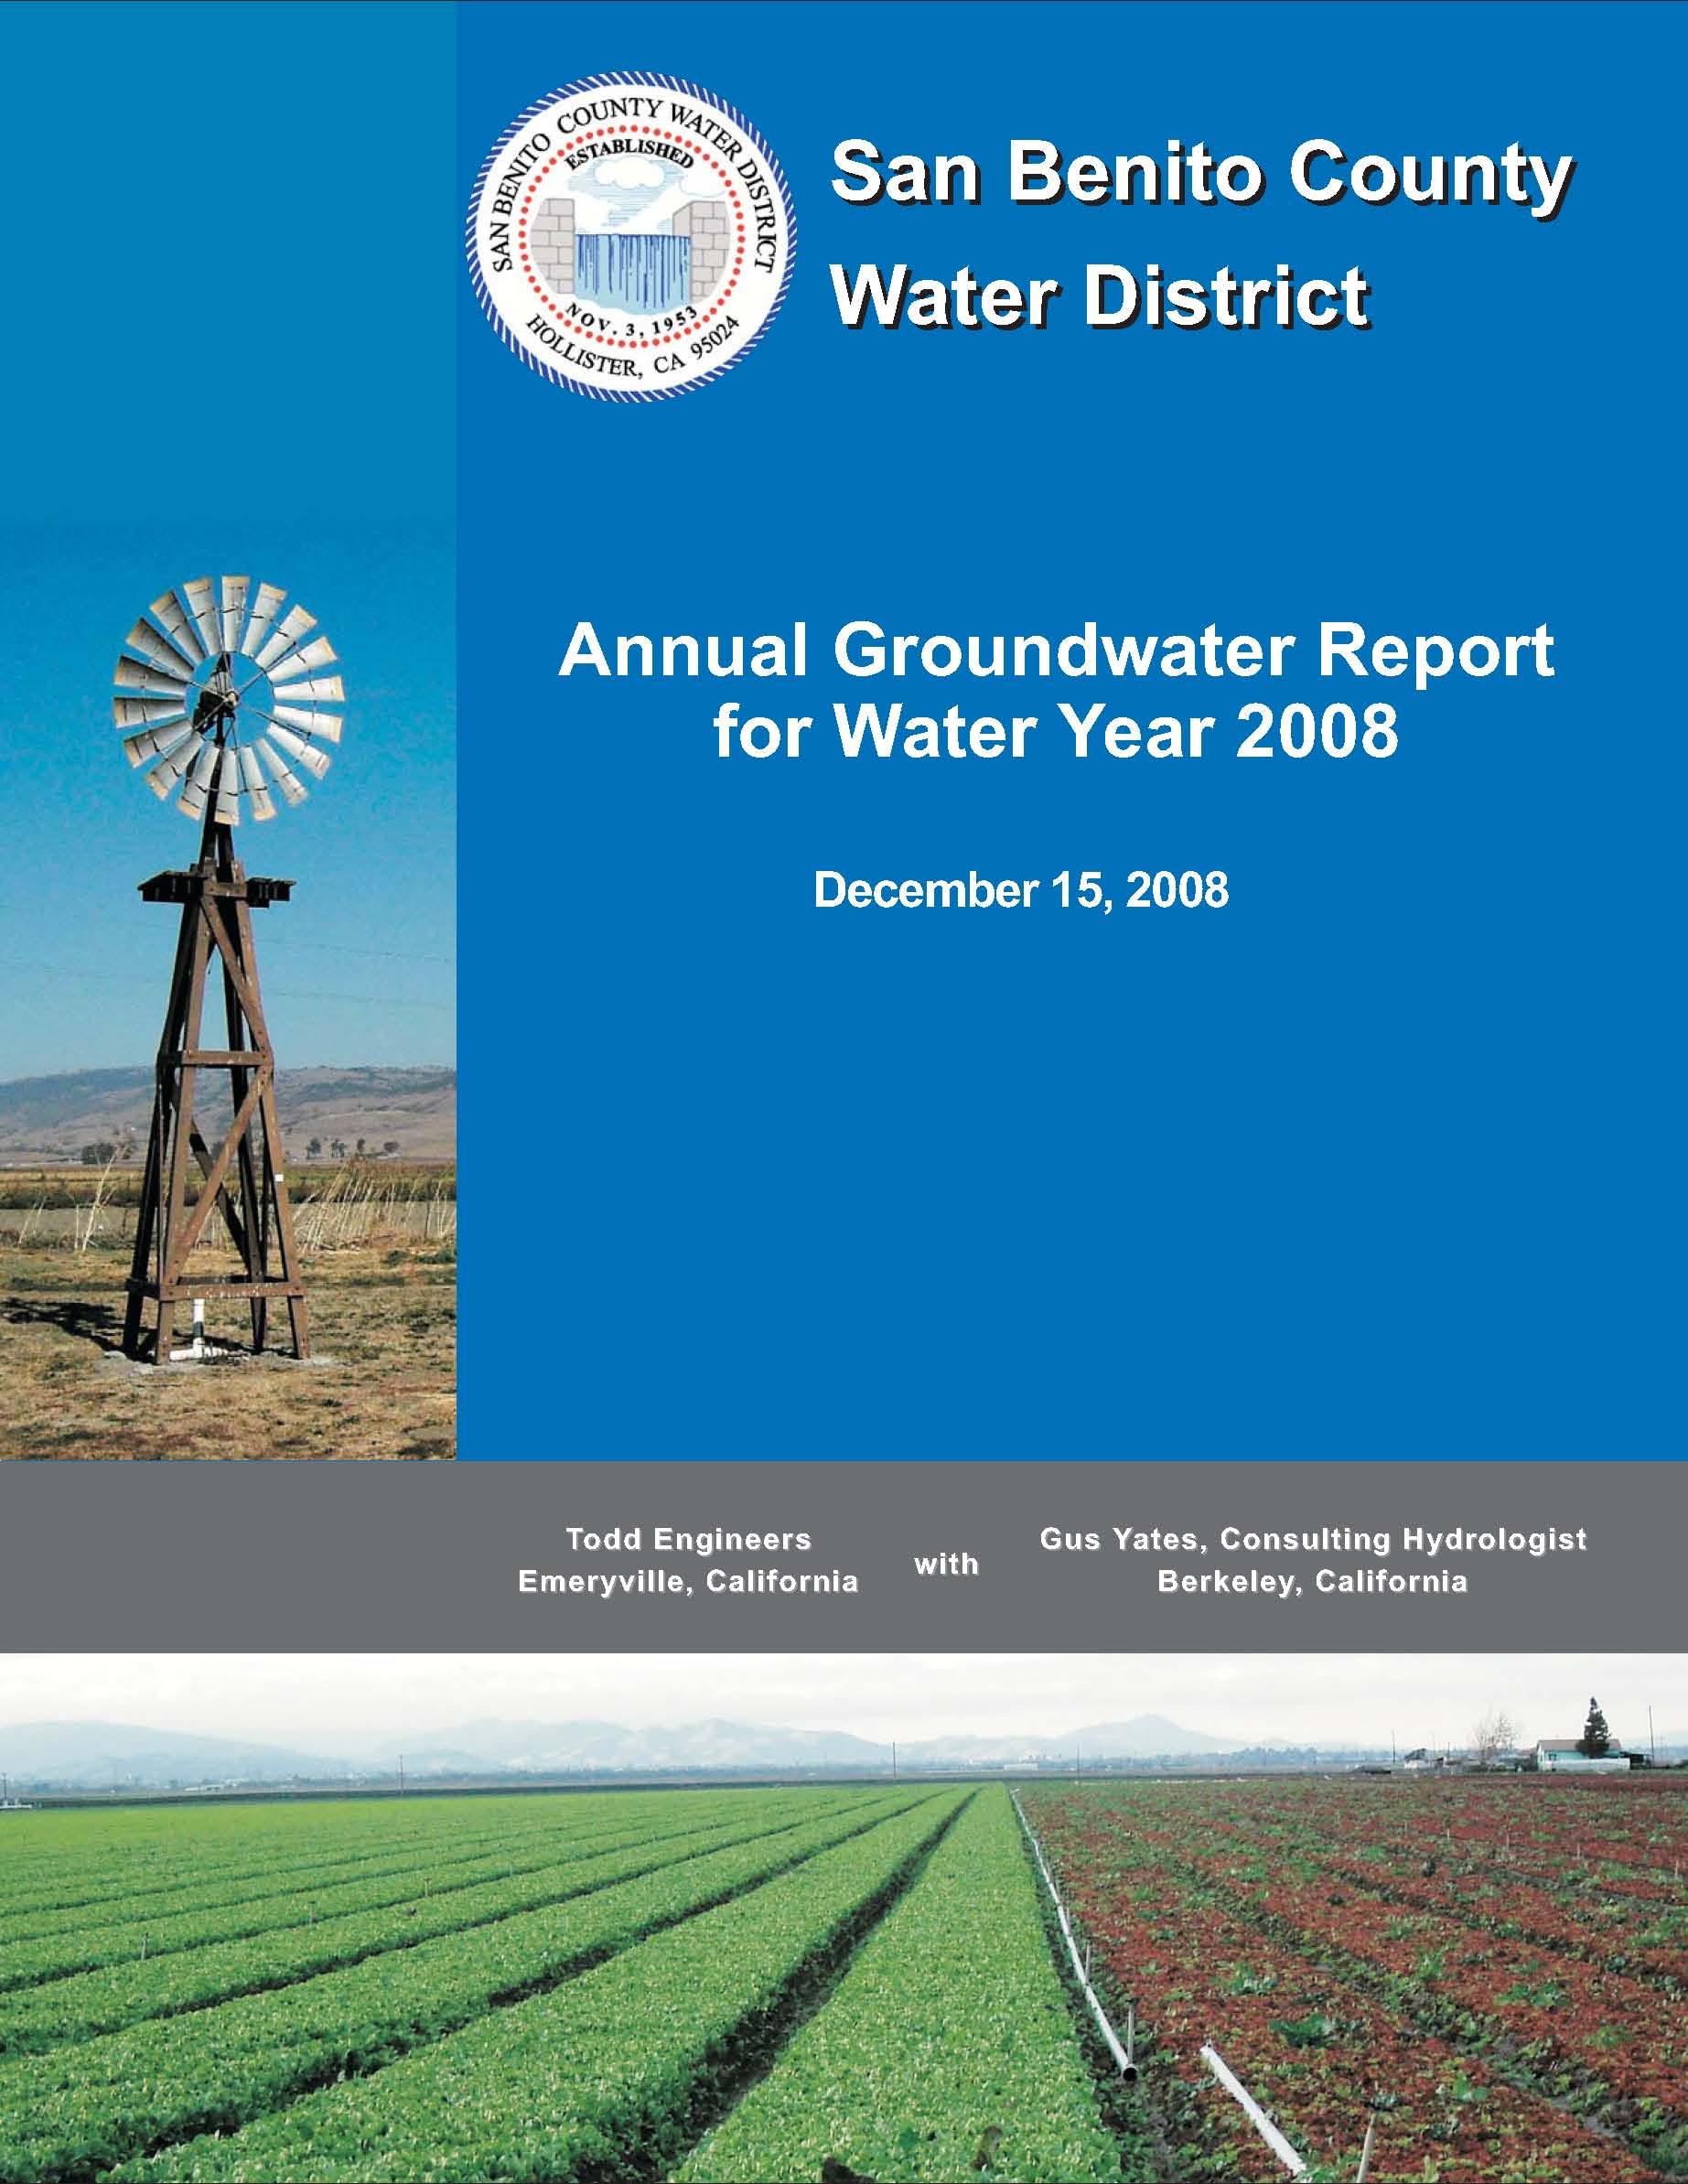
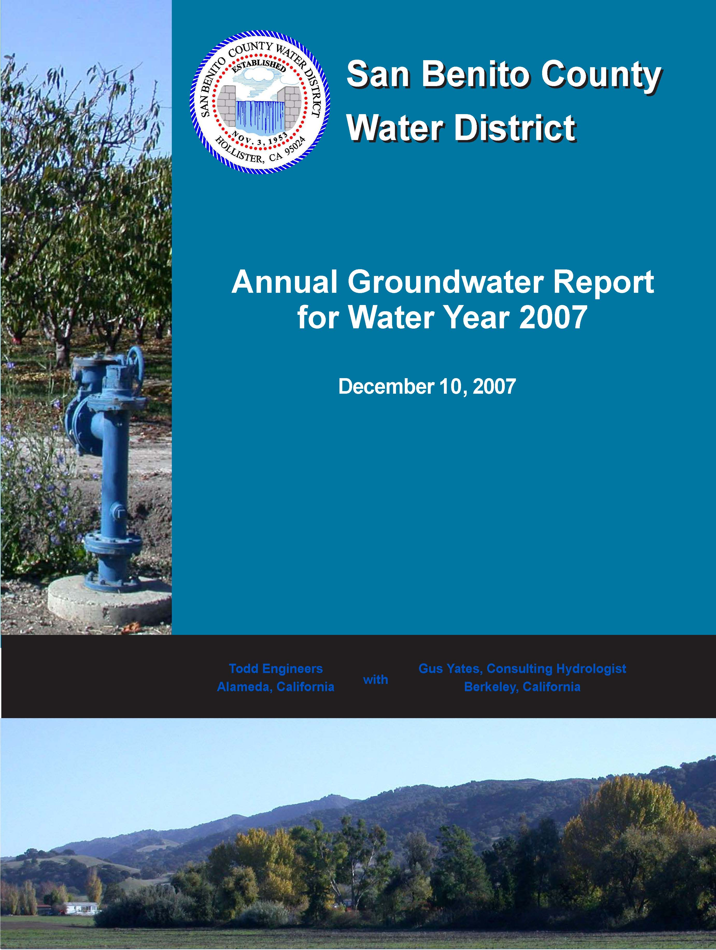
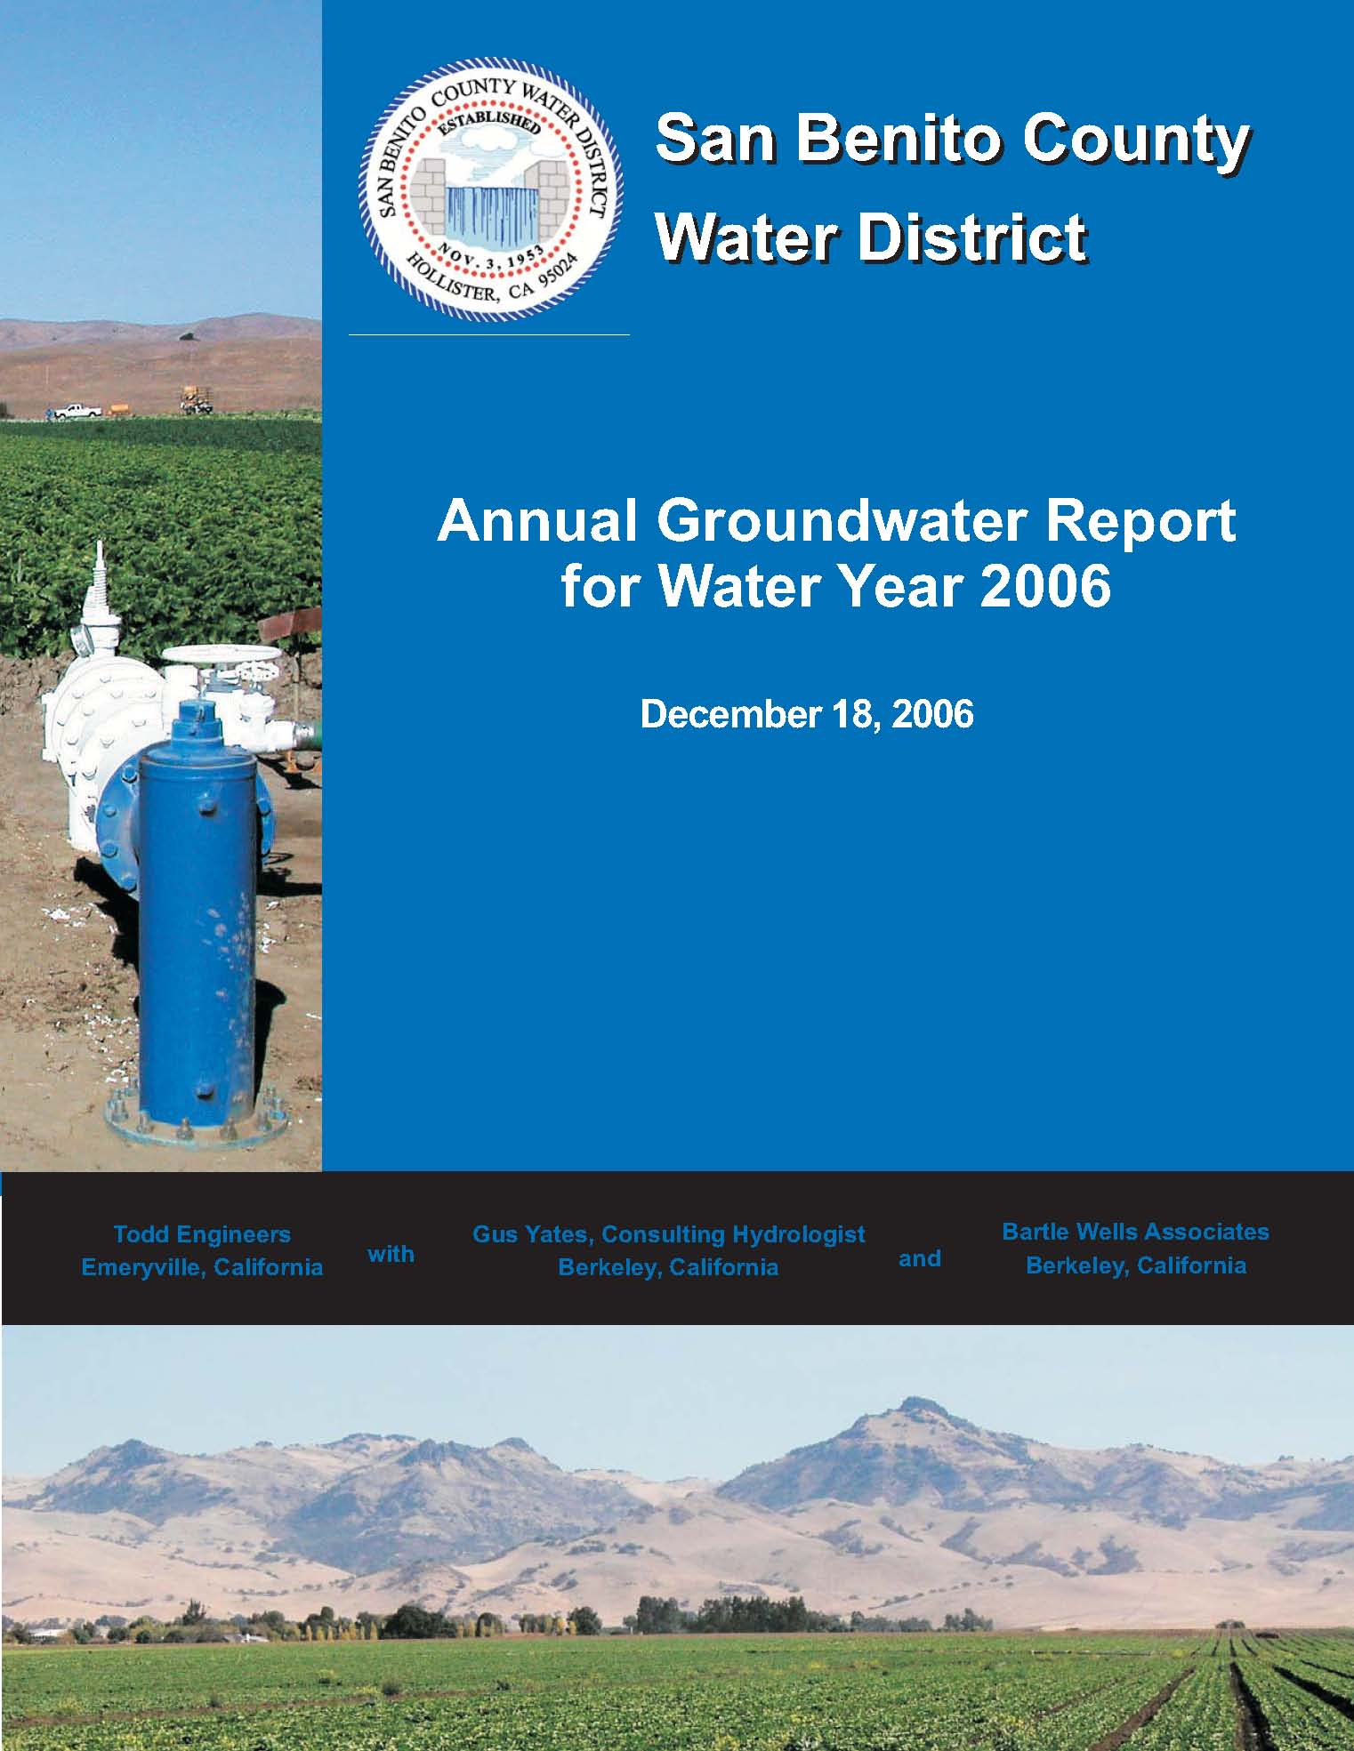
Future Annual Reports
SGMA Annual Reports require items already included in the District Groundwater Report:
  Monitoring data stored in a Data Management System
  General information about basin
  Detailed description of groundwater levels
  Surface water supply by use

Slide 12
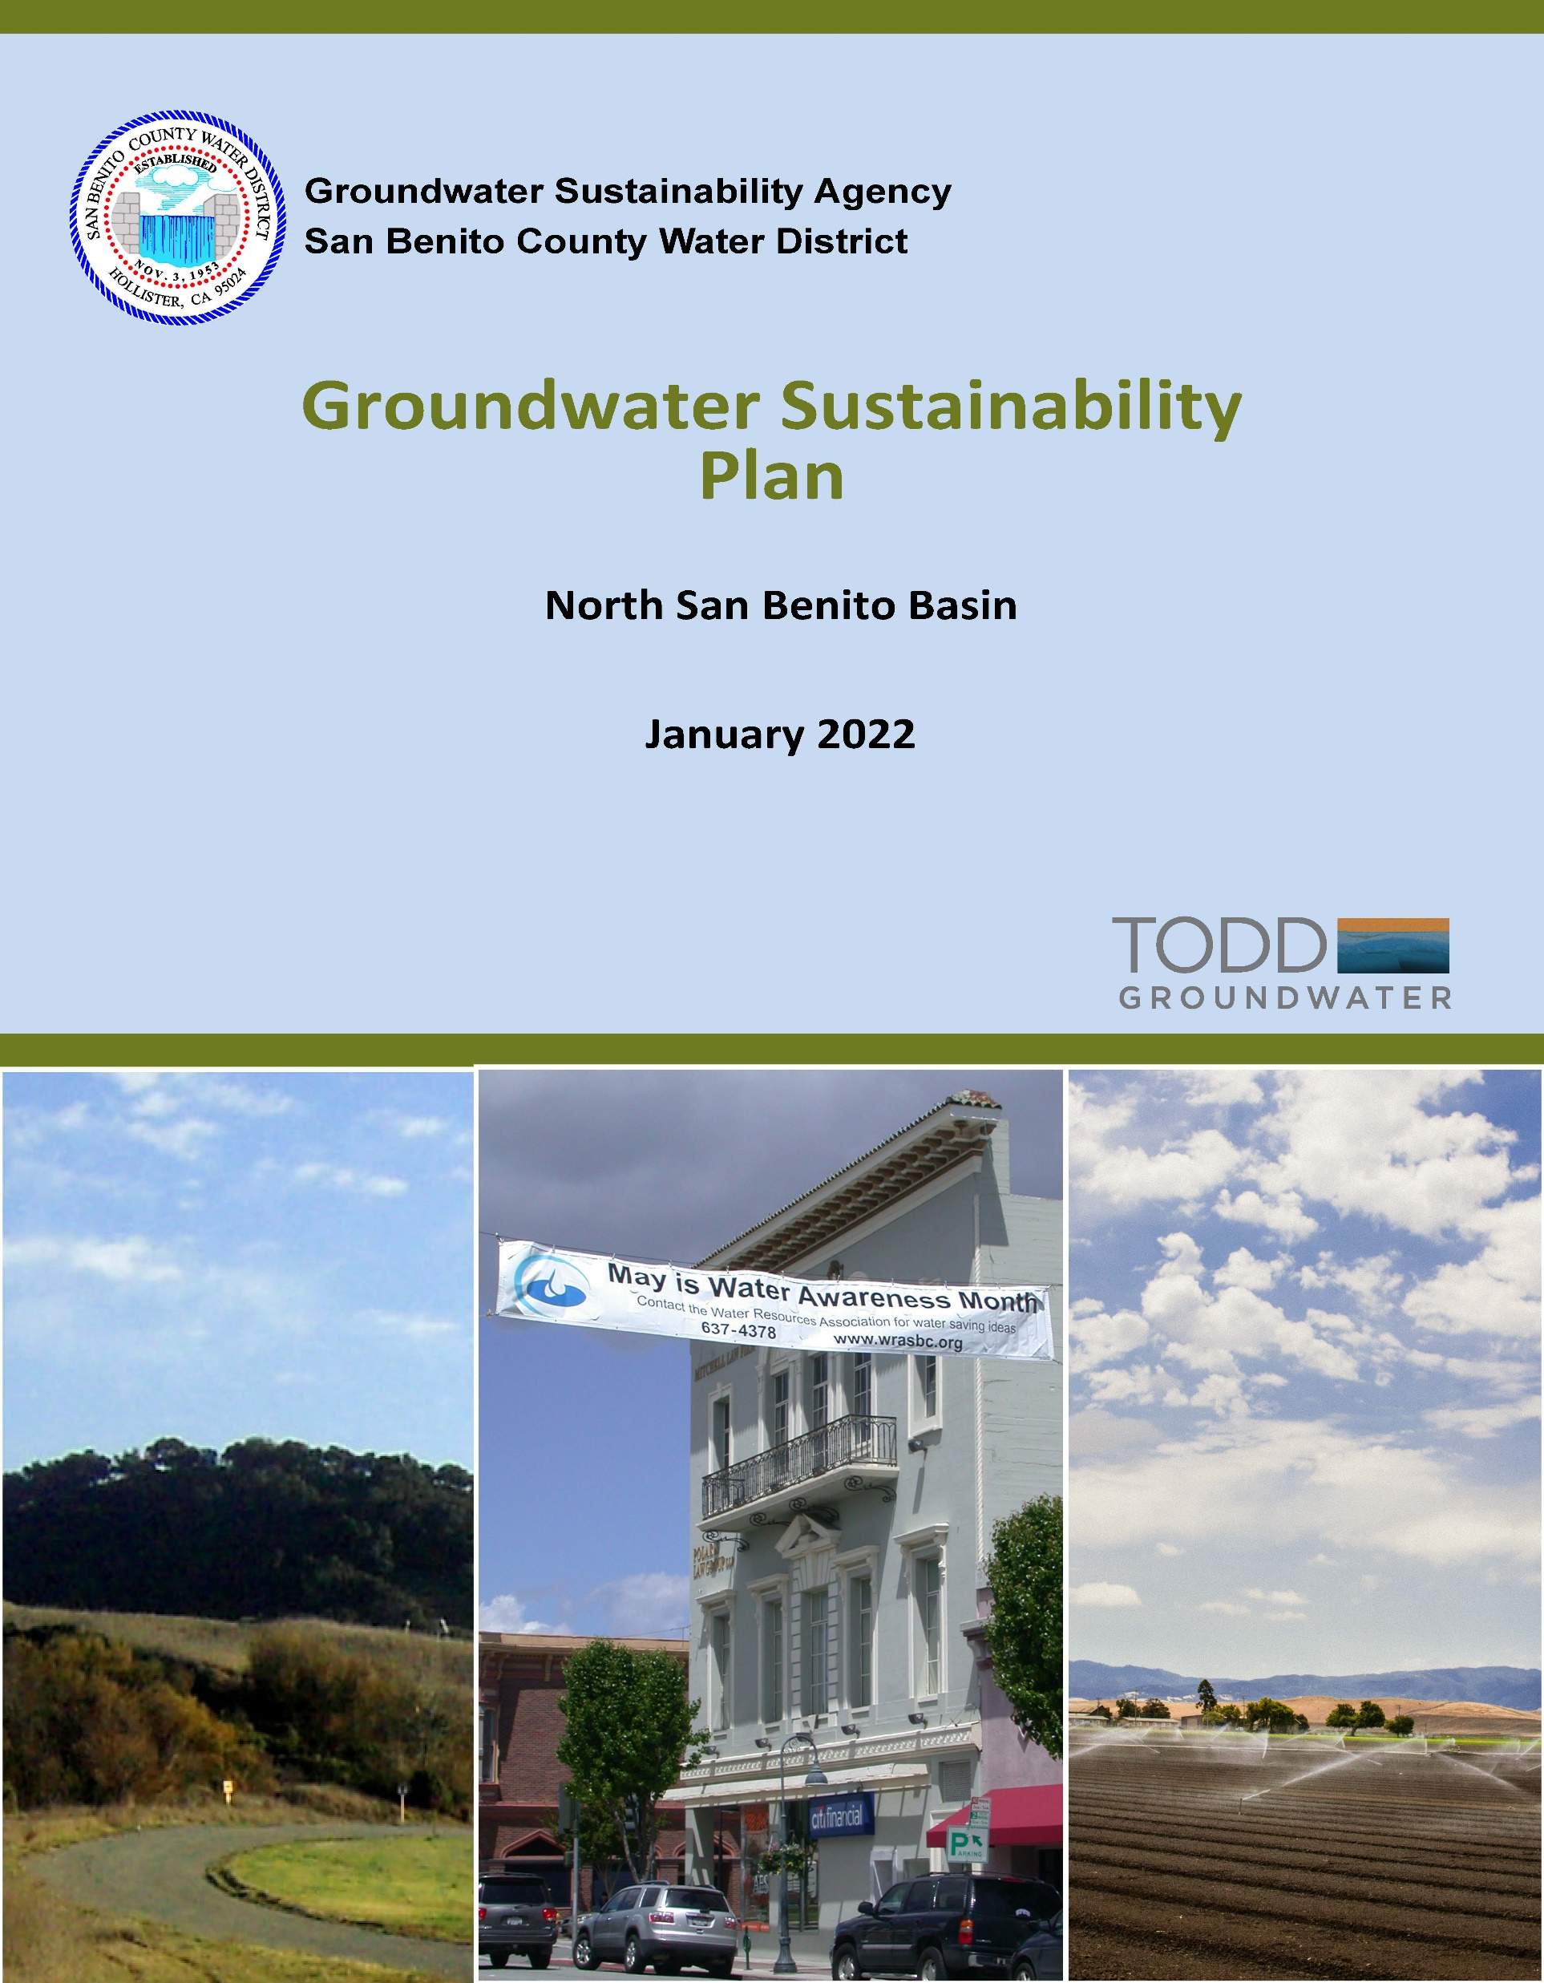
Future Annual Reports
SGMA Annual Reports also require:
  Details on groundwater use
  Groundwater extractions and a map
  Total water use for the entire basin
  Change in storage maps for the entire basin
  Cumulative change in storage from the model
  Description of progress towards implementing the plan.

Slide 13
Future Annual Reports

Slide 14
Increased analysis and tracking
Need a new method to assess groundwater pumping across basin
Annual update and application of the model
Will require more time to prepare annual report

Slide 15
Outlook
Below to near average (?) rainfall and below normal CVP (?) but groundwater available in storage
SGMA supports enhanced monitoring and management
GSP to be completed by January 2022, the first SGMA Annual Report is due April 2022.

Slide 16
Recommendations
Groundwater Charges Zone 6 –
  $13.55 /AF for agricultural
  $40.55 /AF is recommended for M&I
Groundwater Production and Replenishment –
  Focus replenishment on areas that still show lower water levels
Proceed with SGMA
  Prepare a GSP by 2022
  Prepare Annual Reports to satisfy SGMA requirements

Slide 17
Discussion

