Slide 1
Update to Board of Directors: Draft Groundwater Sustainability Plan
San Benito County Water District
Groundwater Sustainability Agency
June 30, 2021 Board Meeting

Slide 2
Overview of the GSP
Introduction
Plan Area
Hydrogeologic Conceptual Model
Groundwater Conditions
Water Balance
Sustainable Management Criteria
Monitoring Network
Projects and Management Actions
Implementation Plan
References

Slide 3
Overview of the GSP: 10 Appendices
A – SBCWD Notices/ Resolutions
B – Memorandum of Understanding available upon request
C – GSP Preparation Checklist (to be added later)
D – Communication Plan (to be added later)
E – Technical Memoranda (Data, Management Areas, DMS)
F – Annual Reports
G – Groundwater Model Update and Enhancement Report
H – Dedicated Monitoring Well Program Technical Memorandum (to be added later)
I – Managed Aquifer Recharge Technical Memorandum (to be added later)
J – List of Public Meetings and Comments on the Plan

Slide 4
Updates to the GSP document
Executive Summary
Completion of Introduction
Addition of CVP importation infrastructure Figure 2-7
Clarification of Water Quality sustainability criteria “Other Constituents” Section 6.6 (and Section 4.8)

Slide 5
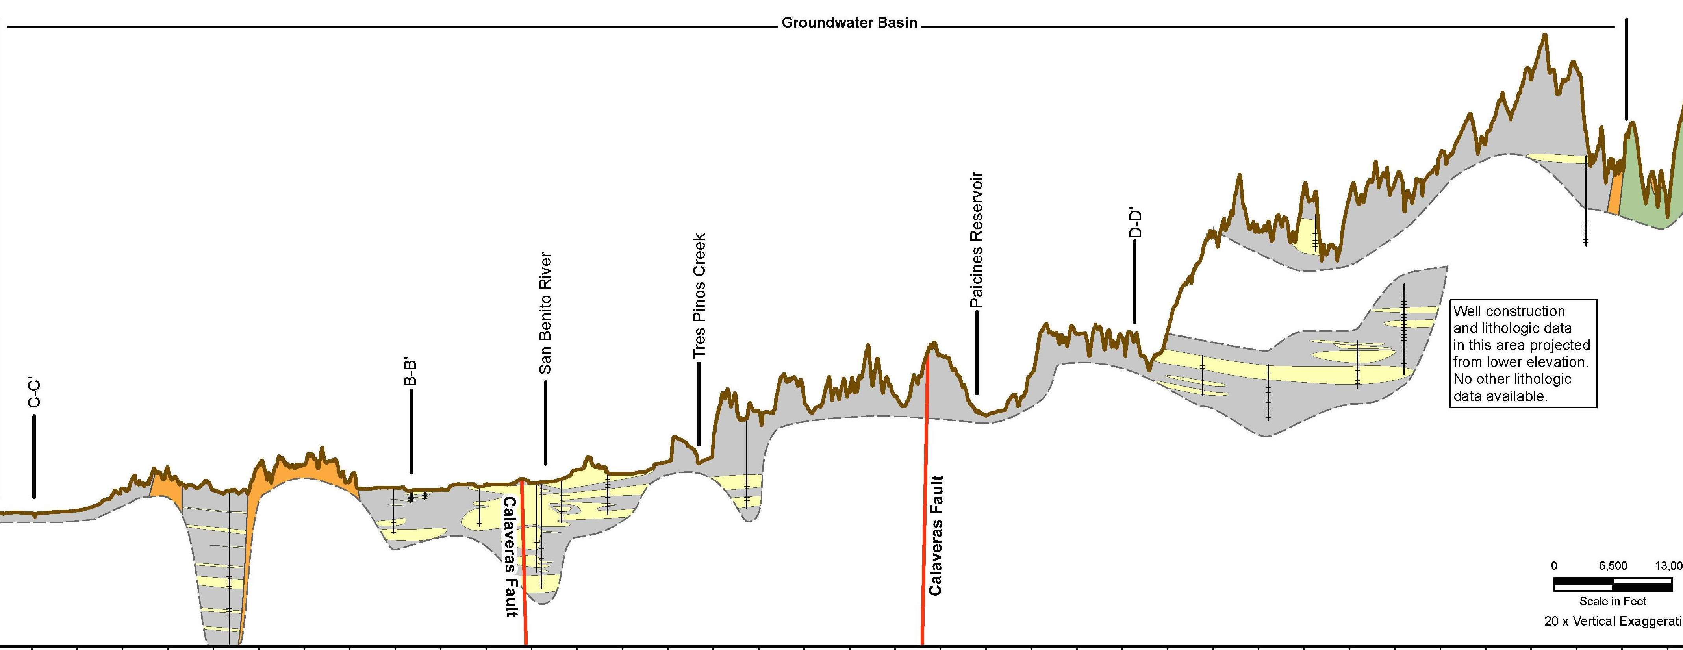
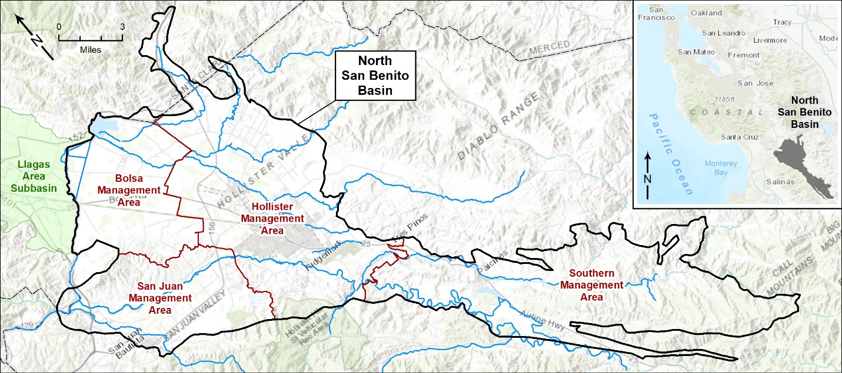
Highlights of the GSP: Hydrogeologic Setting
North San Benito Basin formed in 2019
A long, irregular but continuous basin with one principal aquifer
Four Management Areas
Zone 6 and 3 boundaries
Watershed divides

Slide 6
Groundwater Conditions
Documented for SGMA sustainability indicators
Groundwater elevations
Groundwater storage
Land subsidence
Interconnected surface water and GDEs
Groundwater quality
No seawater intrusion.

Slide 7
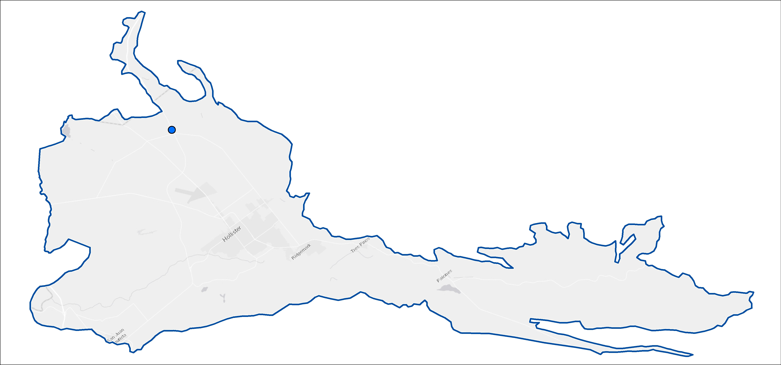
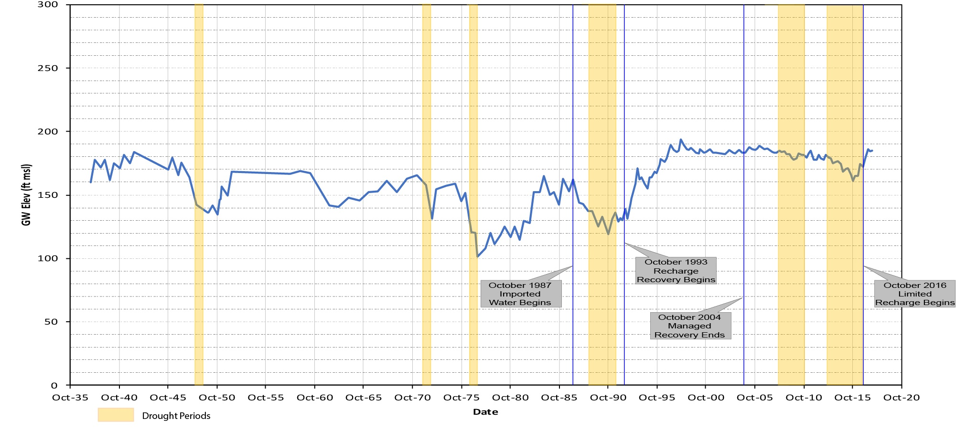
Groundwater levels and storage
Groundwater level declines have been reversed with CVP water
Groundwater levels / storage generally increased and stabilized
11-5-35G1

Slide 8
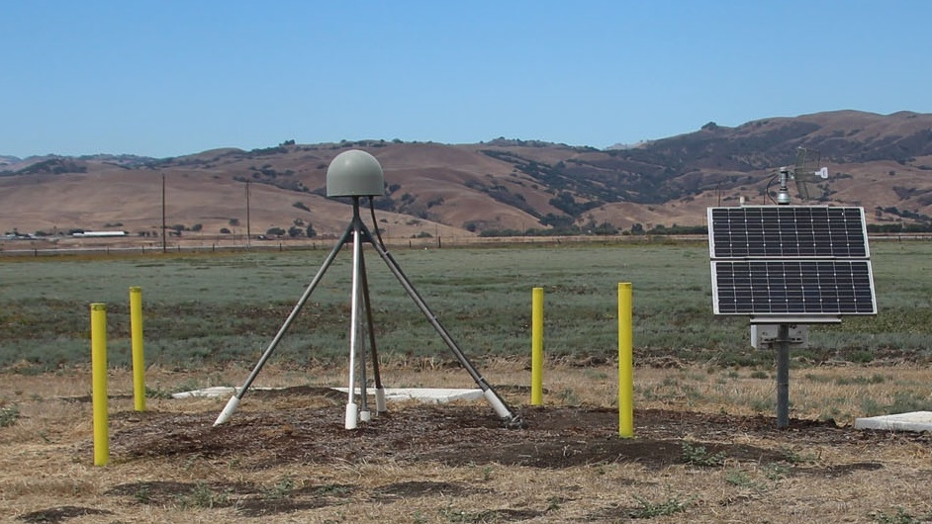
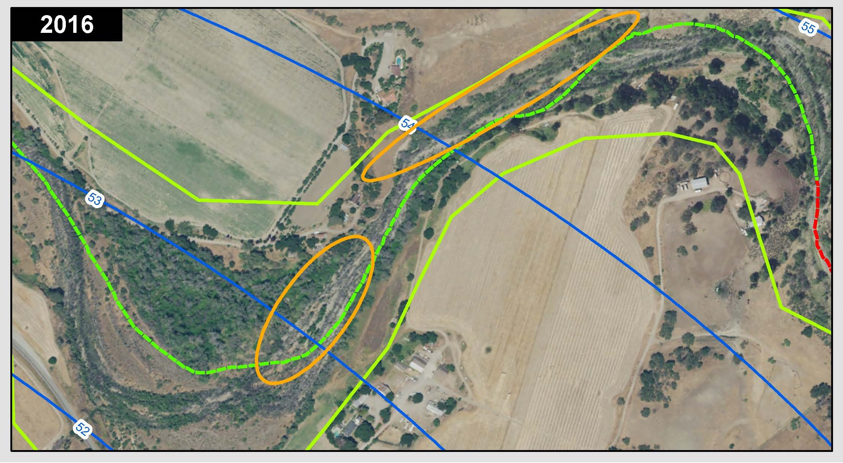
Groundwater Conditions
Connected surface water - GDEs
Evaluated areas of connected surface water and groundwater
Identified stream reaches with riparian vegetation and potential steelhead habitat
Assessed potential impacts of pumping, drought, floods
Land subsidence
Uneven land settlement due to pumping and groundwater level decline
Not a known problem in North San Benito Basin
Indicated by satellite data to occur

Slide 9
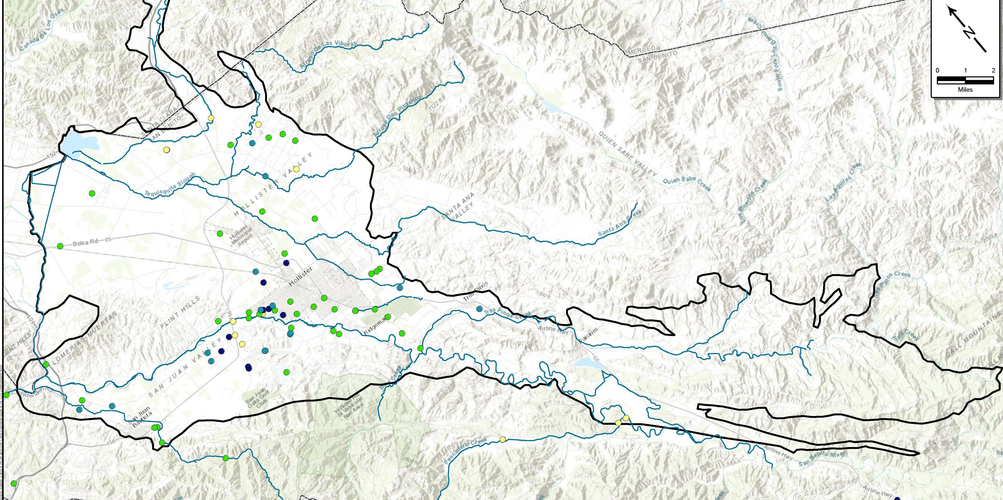
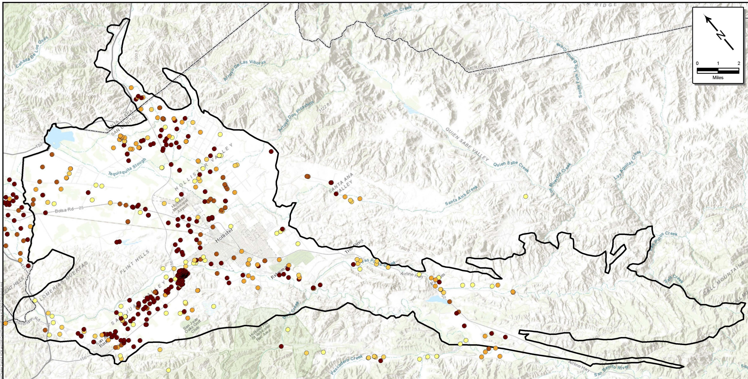
Groundwater Quality: Key constituents
Total dissolved solids TDS
Naturally high
Affected by irrigation return flows, wastewater disposal, etc.
Nitrate
Elevated due to agricultural activities, confined animal facilities, landscape fertilization, septic systems, and wastewater treatment facility discharges

Slide 10
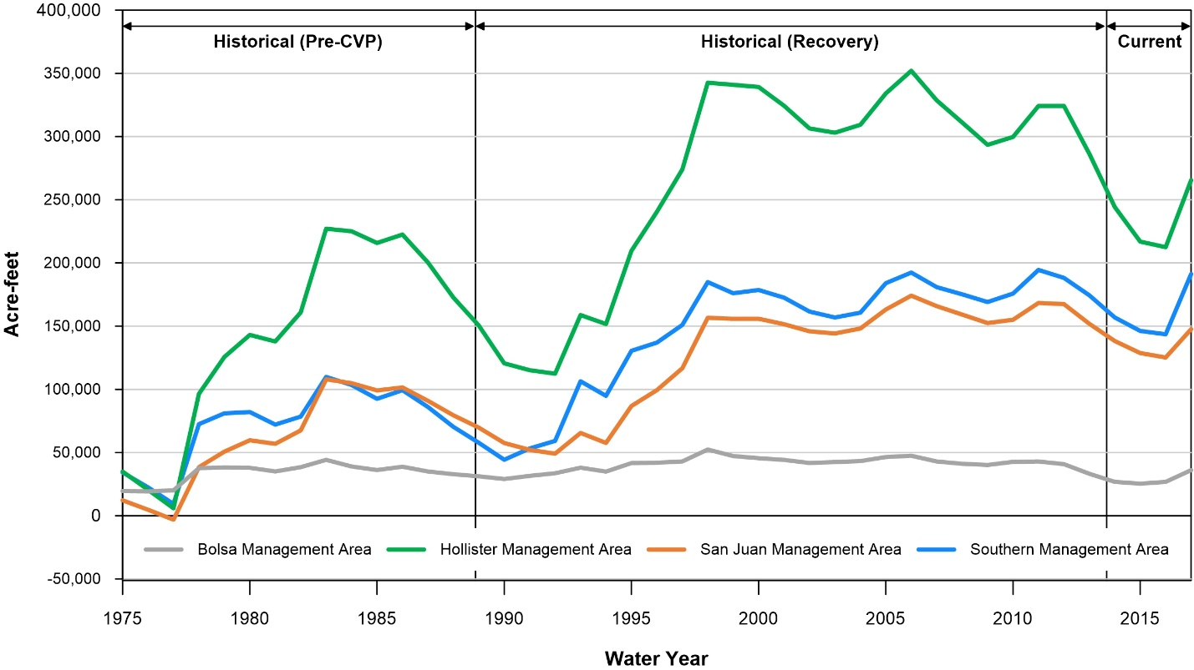
Water Balances
Developed using numerical model:
Historical and current conditions
Pre-CVP Historical
Historical Recovery
Current
Future Baseline
Future Climate Change
Future Growth
Cumulative change in storage, historical and current conditions

Slide 11
Water balance findings
Baseline pumping of 90,089 AFY is sustainable into the future
Climate change scenarios
Hollister, San Juan, Bolsa MAs have lower water levels between wet periods, but declines did not become larger over time
In Southern MA, increased storage and water levels is indicated
Growth scenarios
Lowered water levels in Hollister and Bolsa MAs, raised levels in San Juan MA, and little effect in Southern MA
Effects of climate change and growth would be additive: lowered water levels might reach minimum thresholds locally

Slide 12
Sustainable Management
For each sustainability indicator, GSP defines
Undesirable Result – significant and unreasonable conditions for any of the sustainability indicators
Minimum Threshold (MT) – numeric value used to define undesirable results for each sustainability indicator.
Measurable Objective (MO) – specific, quantifiable goal to track the performance of sustainable management.

Slide 13
Groundwater levels and storage
Groundwater levels are sustainable
MT is based on historical low levels or adjusted higher
Measured at key wells
Two consecutive occurrences in 60% of key wells would be undesirable
Groundwater storage is sustainable
Groundwater levels MT is the proxy, protective of storage

Slide 14
Subsidence and GDEs
Land subsidence
No problems known
Objective is to prevent subsidence
Potential exists, so MT established
0.2 feet/5 years (> 1 ft since 2015)
Significant subsidence is unlikely to occur if groundwater levels stay above historical lows
Interconnected surface water-GDEs
Distribution and health of riparian vegetation shows little correlation to groundwater levels
Steelhead smolt migration might be impacted by pumping
Groundwater levels in near-stream wells from 1987-1992 drought used as proxy
Near-stream shallow monitoring wells needed (six being installed in 2021)

Slide 15
Water Quality
Considered sustainable given that beneficial uses are continuing
Legacy loading is a source of uncertainty in the short term
Implementation of management actions will make a difference in the long run
Total dissolved solids
Using data from triennial updates
MT is defined as % wells exceeding the Basin Plan Objective of 1,200 mg/L
Nitrate
Using data from triennial updates
MT is defined as % wells exceeding the MCL of 45 mg/L

Slide 16
Projects and Management Actions
Projects are substantial efforts that involve an increase in water supply or a reduction in demand
Actions provide a framework for groundwater management
establishing policies
filling data gaps with scientific studies or improved monitoring
providing for funding

Slide 17
Projects improve water balance and quality
Develop Surface Water Storage
Pacheco Reservoir Expansion Project
Expand Managed Aquifer Recharge
“Round 3” MAR project
Enhance Conjunctive Use
Enhance Conservation
Urban
Agricultural
Hollister Urban Area Water / WW Plan
New local reservoir?
Zone 3 Operations Planning Tool
San Juan Bautista Regional Solution
North County Project

Slide 18
Management actions and monitoring
Improve monitoring program and data management system (DMS)
Develop response plans
Enhance water quality improvement programs
Reduce potential impacts to GDEs (steelhead and riparian vegetation)
Provide long-term basin-wide funding mechanism
Provide administration, monitoring, and reporting

Slide 19
Funding for basin-wide sustainable management
A GSA is authorized to impose fees to fund GSP costs including monitoring and reporting
Fees can be based on acreage or volume of groundwater pumped
Groundwater Management fee based on analysis of GSP costs
Parcels categorized as follows:
Areas Benefiting from GSP
Upland Areas with Insignificant GSP Benefit
Major Municipal and Industrial Areas
Santa Clara County

Slide 20
Next Steps
SBCWD GSA Board of Directors Meeting on Groundwater Management Fee
Public Workshop and review period
Round 3 MAR feasibility study completion
Round 3 monitoring well installations
Final GSP
Adoption
Implementation

